Slide 1
Honeybees, other Insects and Pollination
Andy Crews

Slide 2
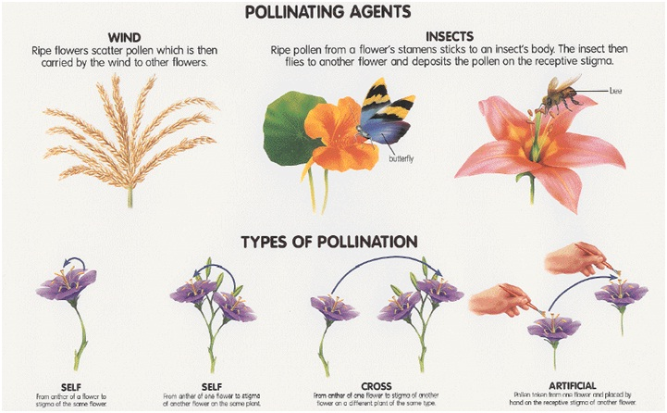

Slide 3
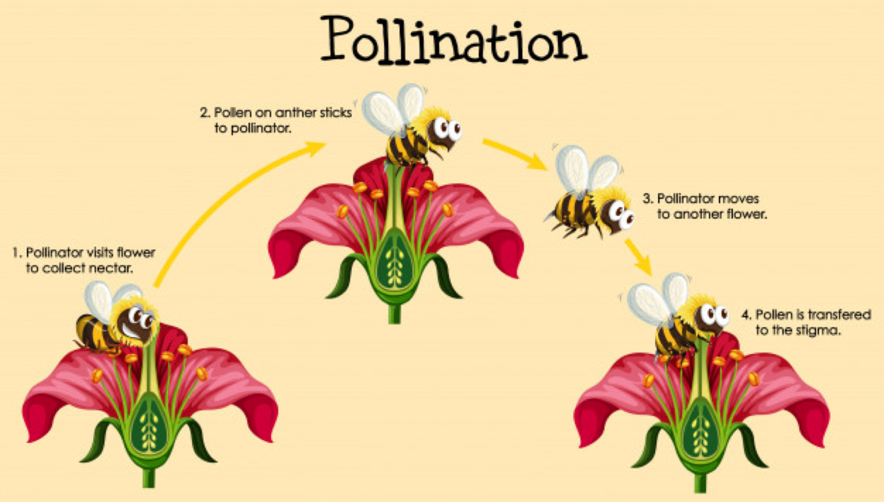

Slide 4
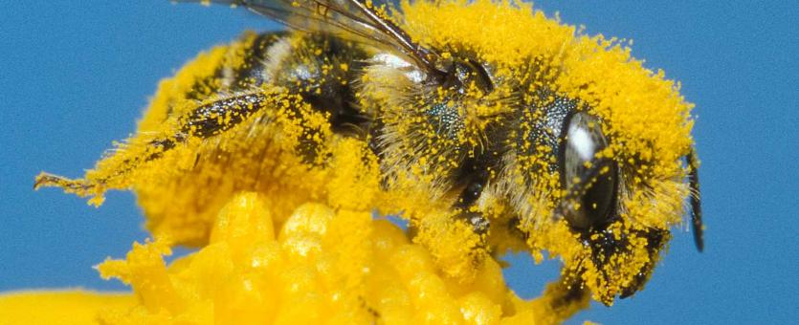
Collecting Pollen is a Messy Business!

Slide 5
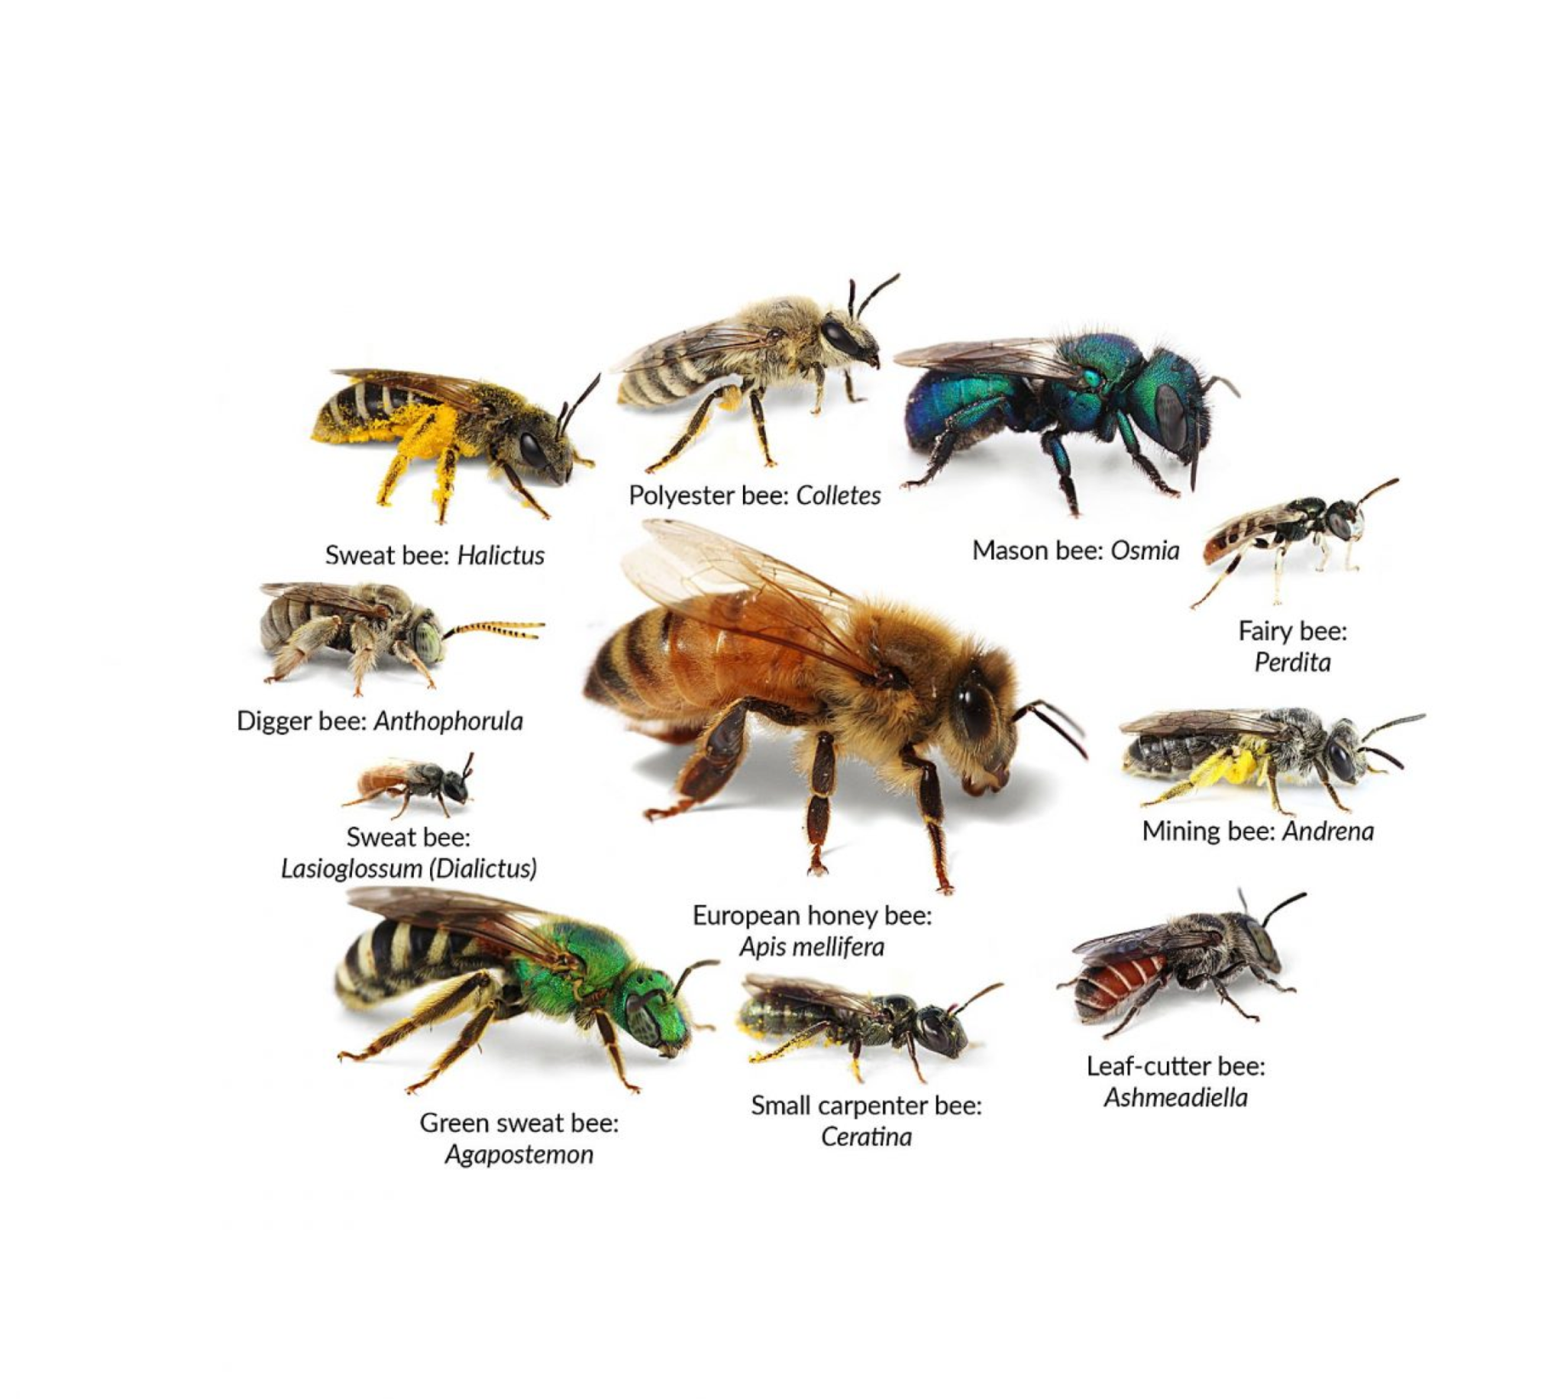

Slide 6
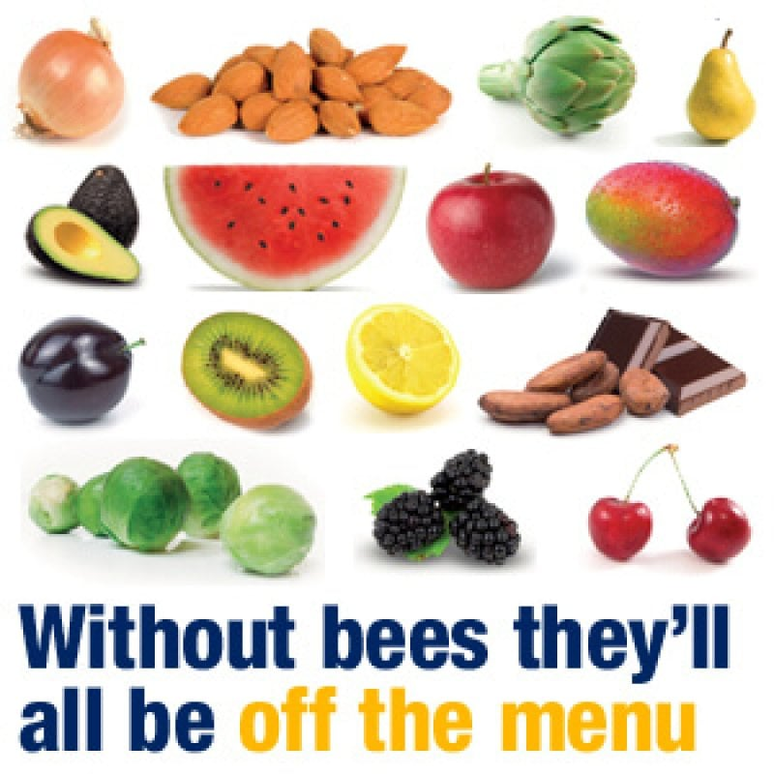

Slide 7
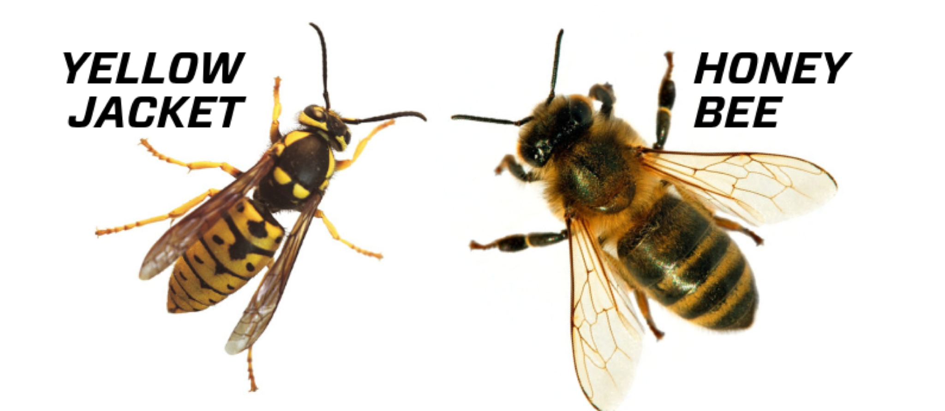

Slide 8
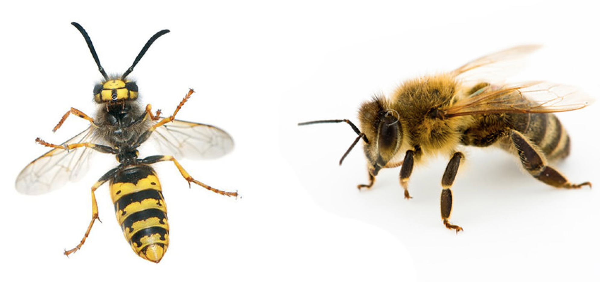
Wasp & Honeybee

Slide 9
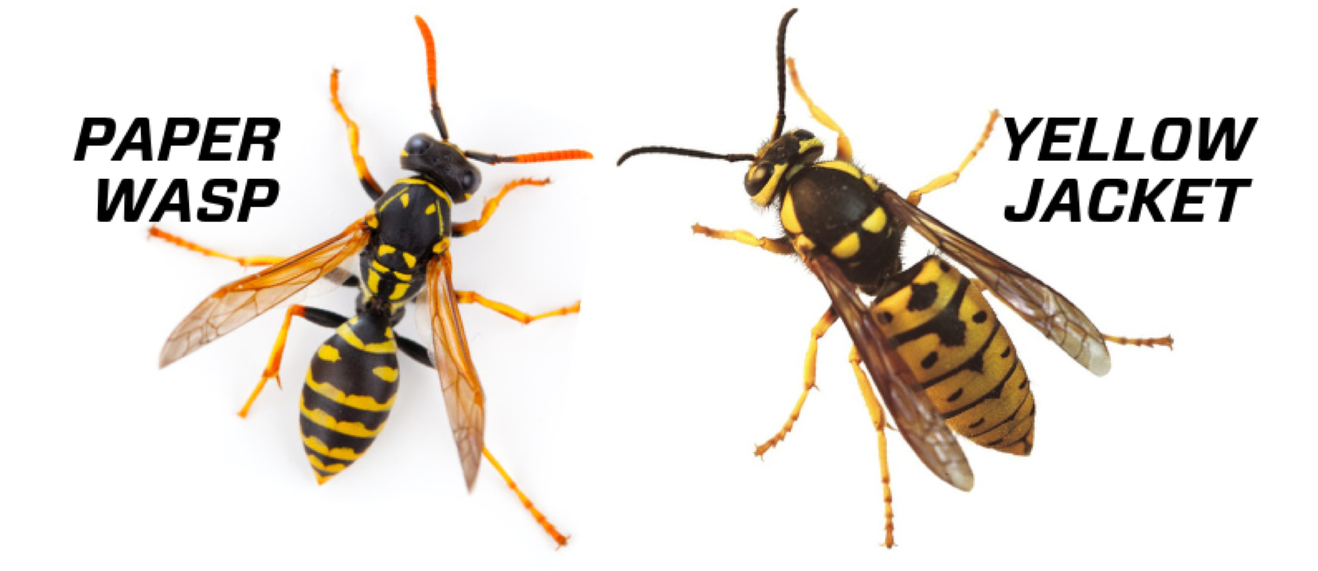

Slide 10
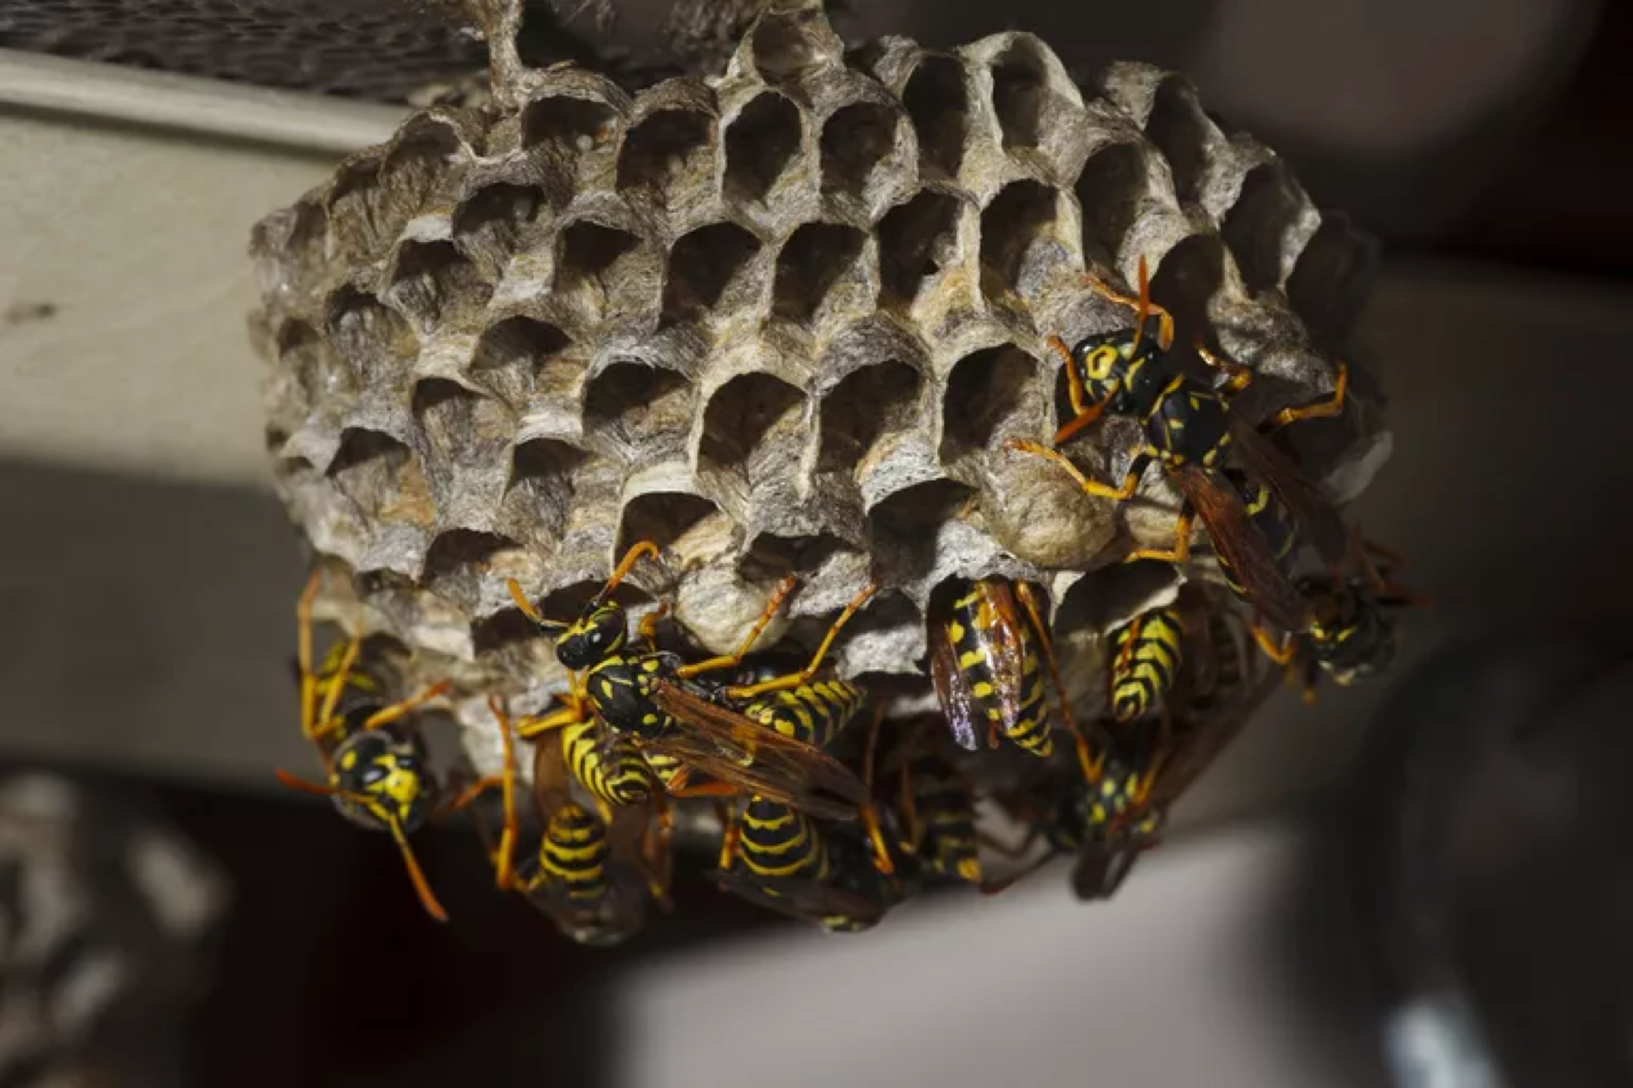
Paper wasp nest

Slide 11
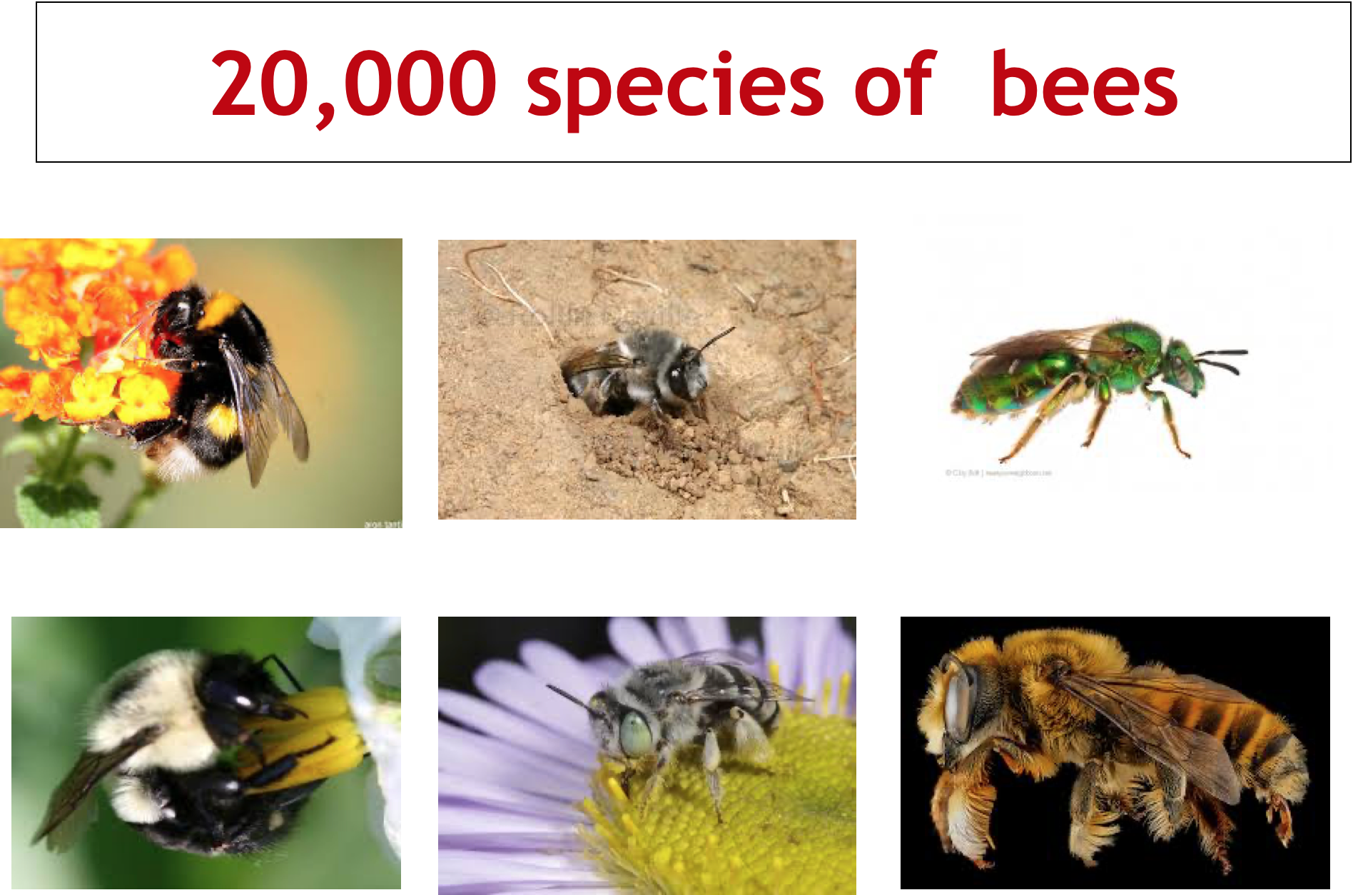

Slide 12
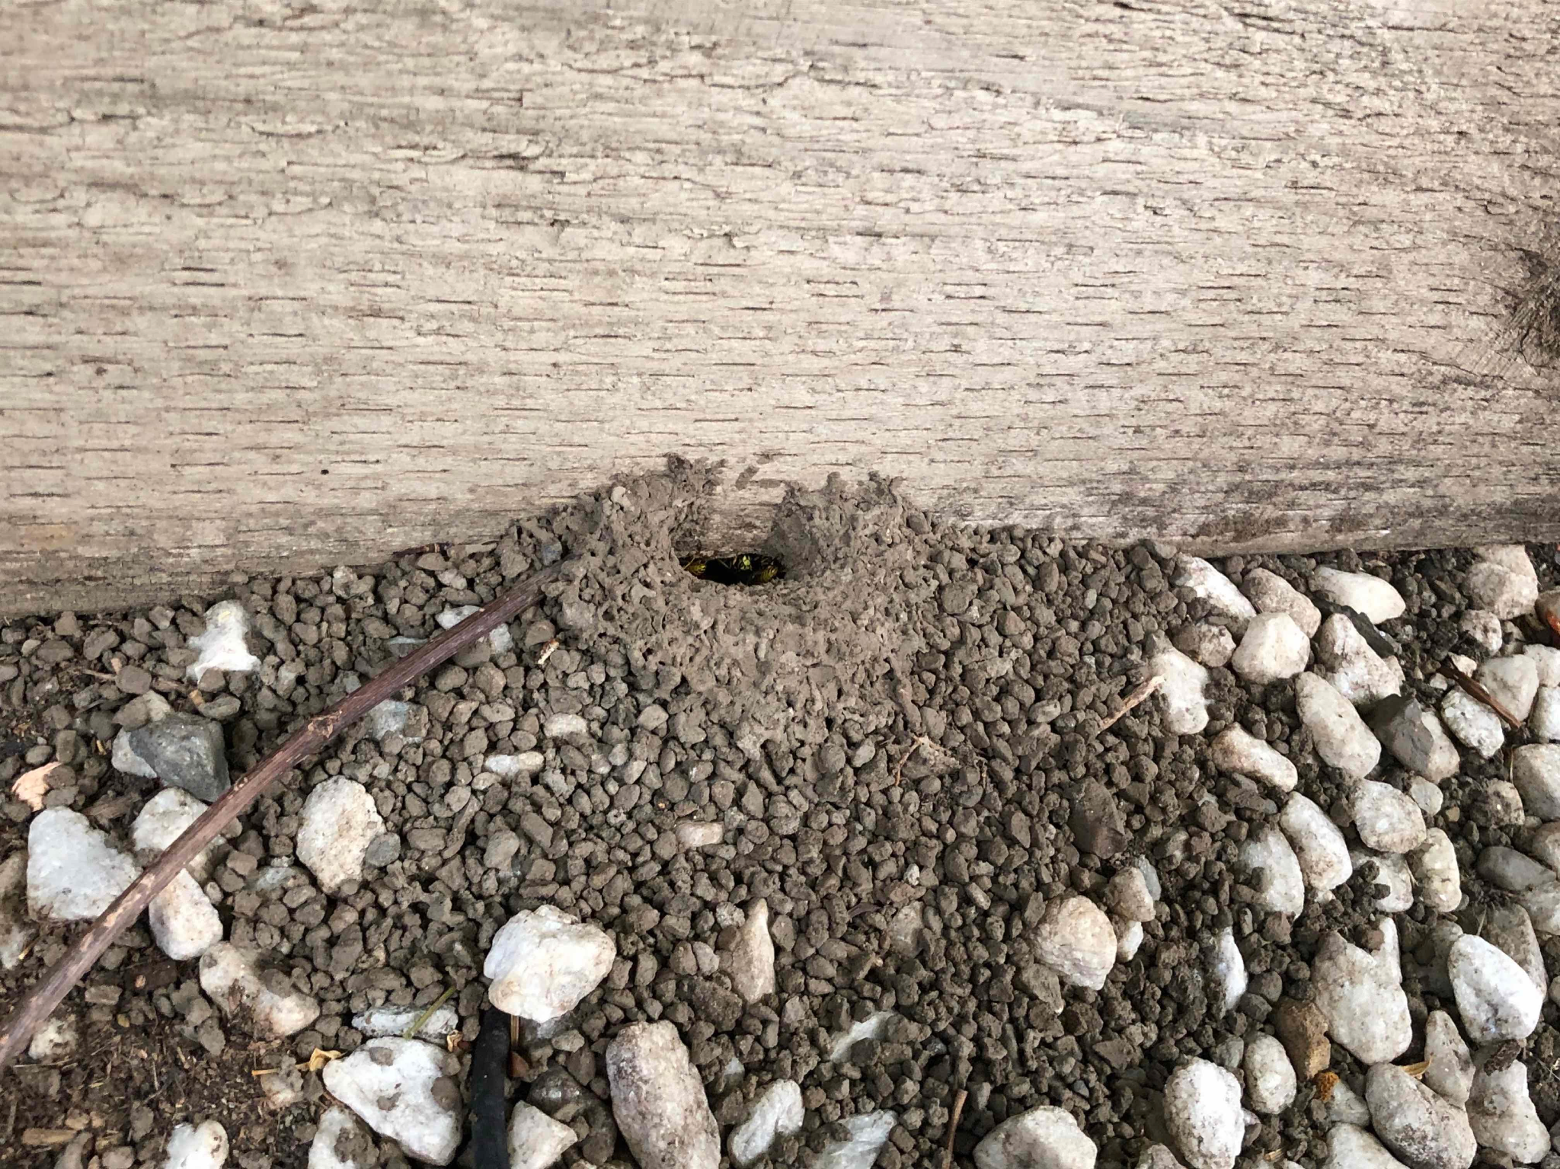
Yellow jacket hive

Slide 13
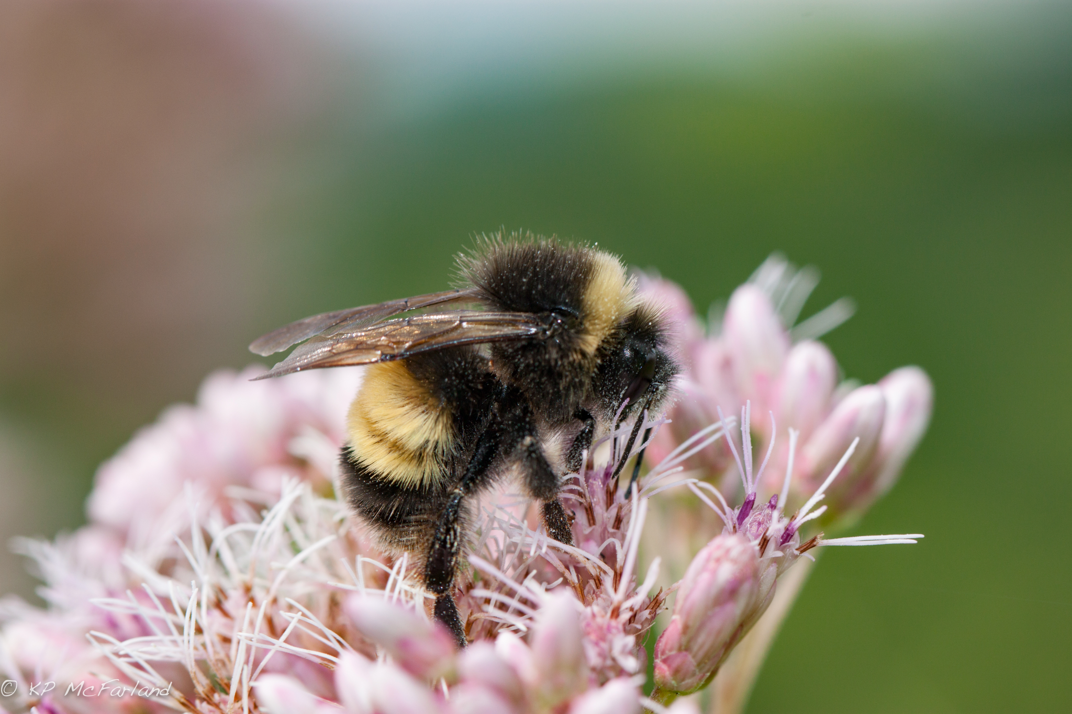

Slide 14
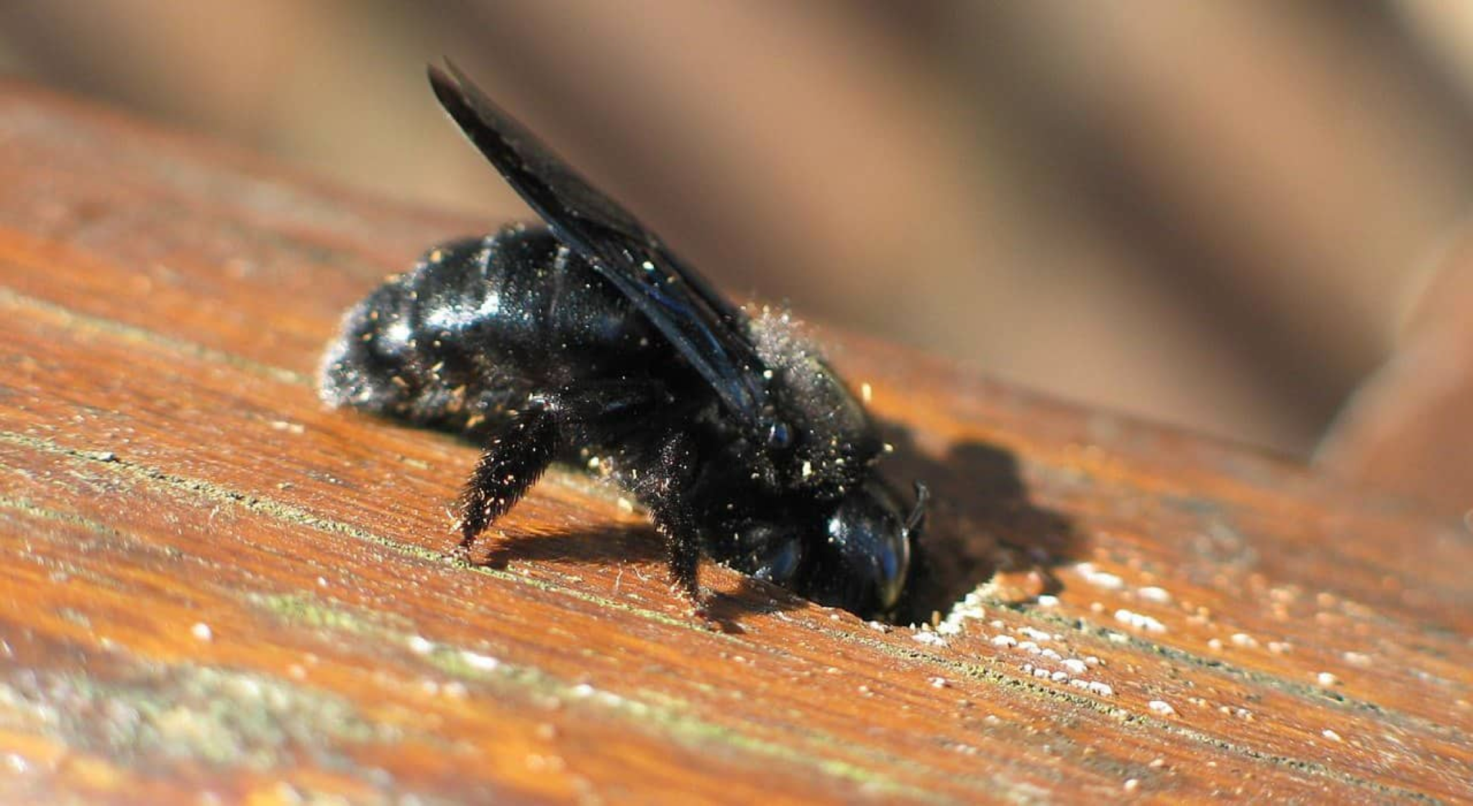

Slide 15
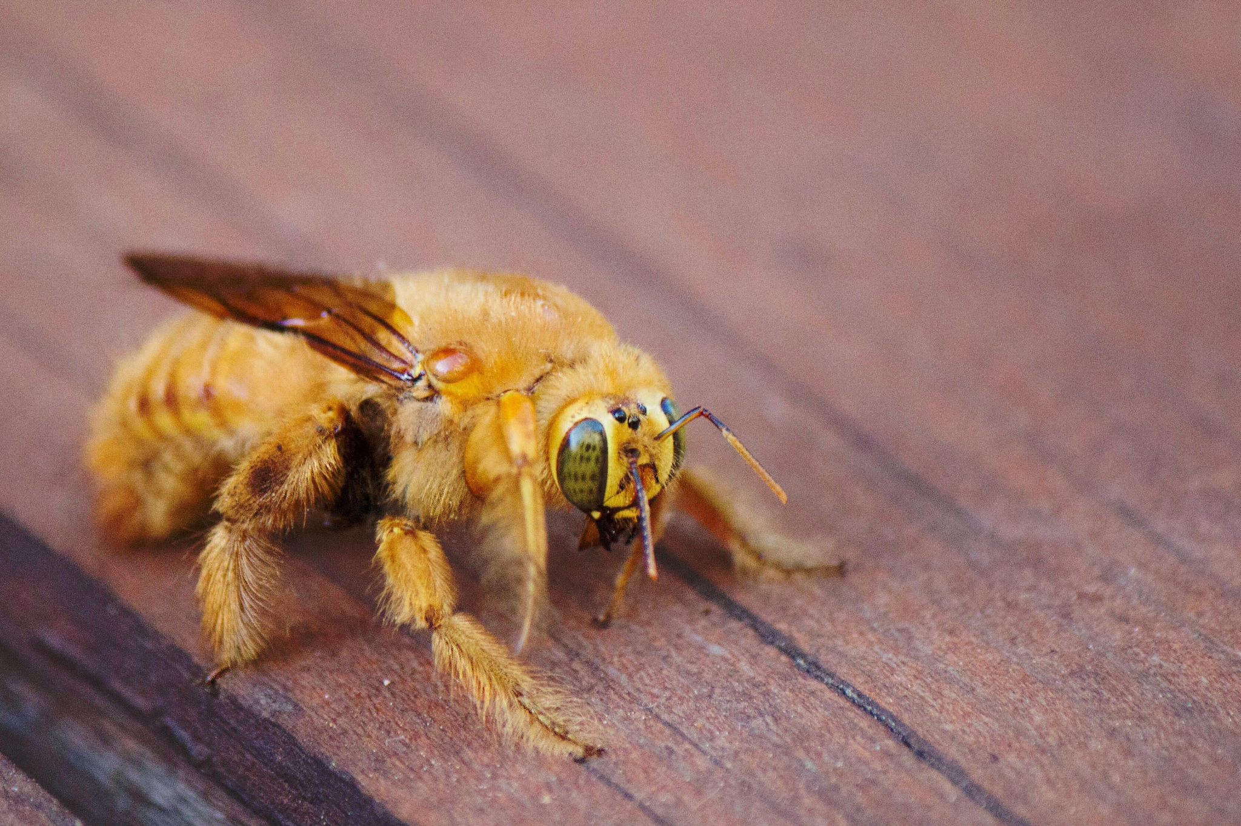
Valley Carpenter Bee

Slide 16
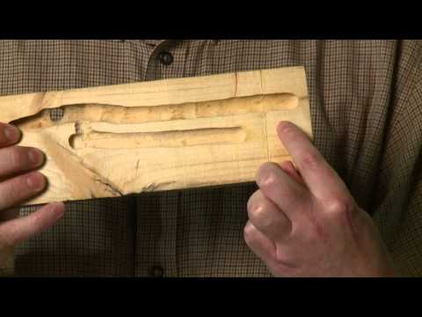

Slide 17
What makes honeybees different from all other kinds of bees?

Slide 19
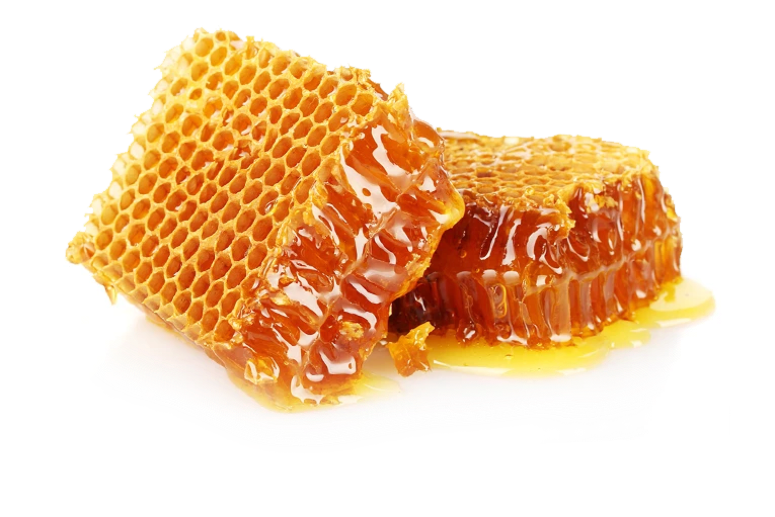
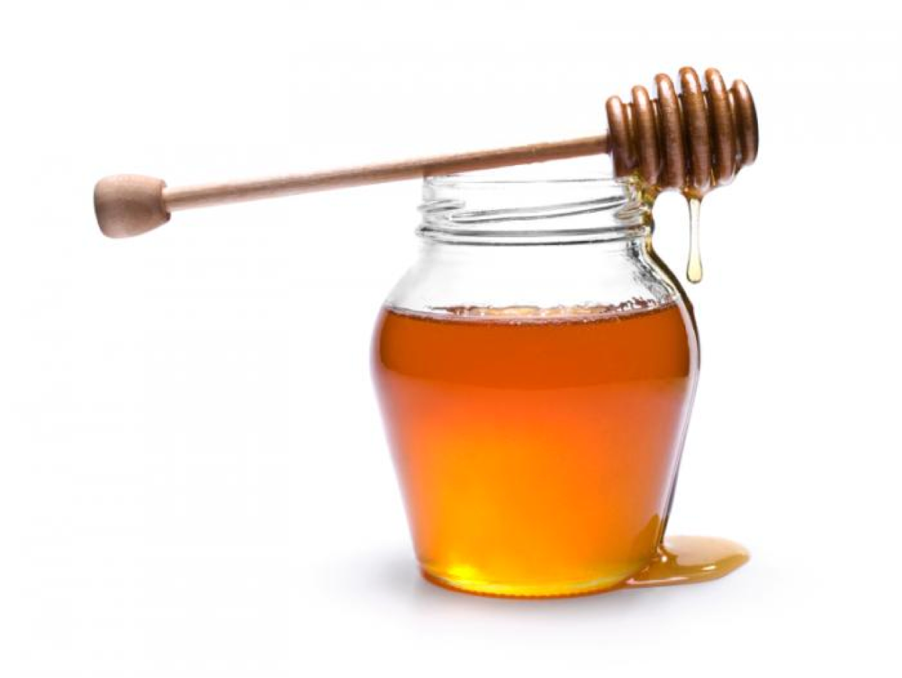
Honeybees make honey

Slide 20
What do honeybees look like?

Slide 21
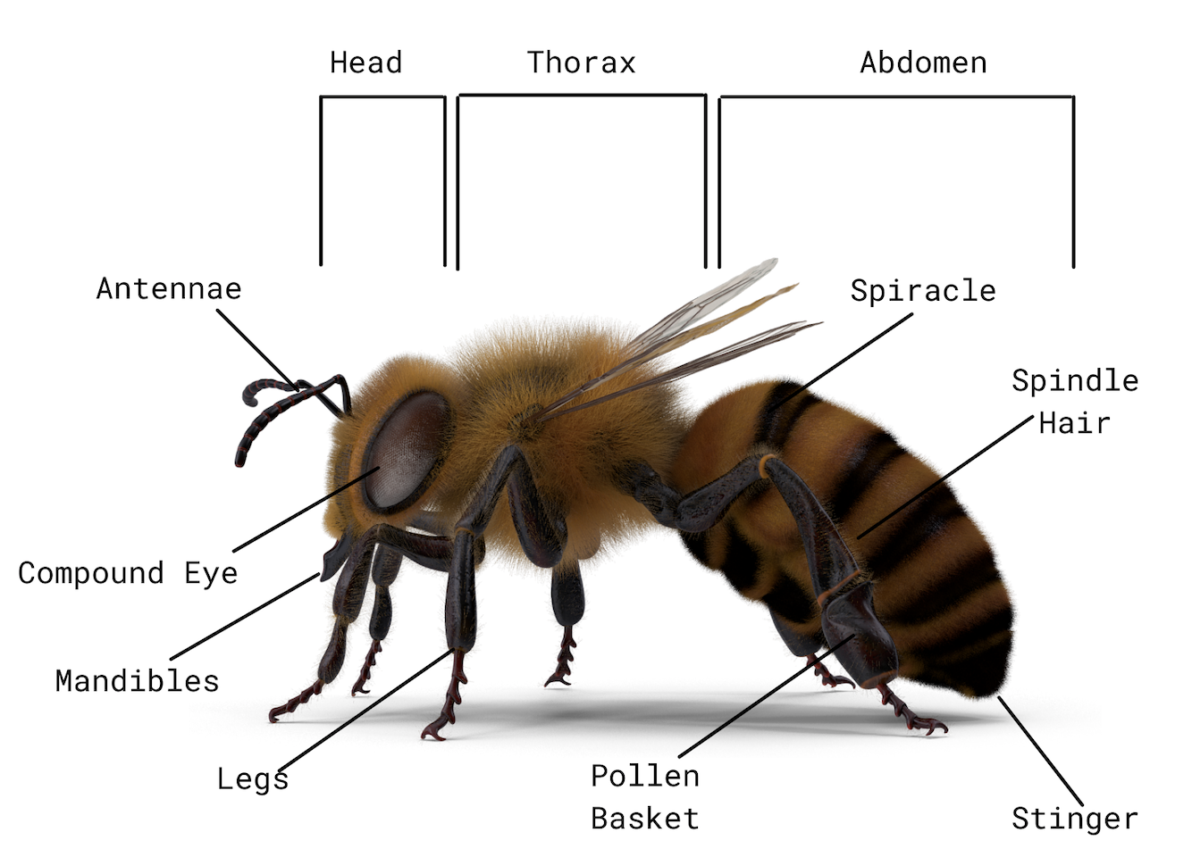

Slide 22
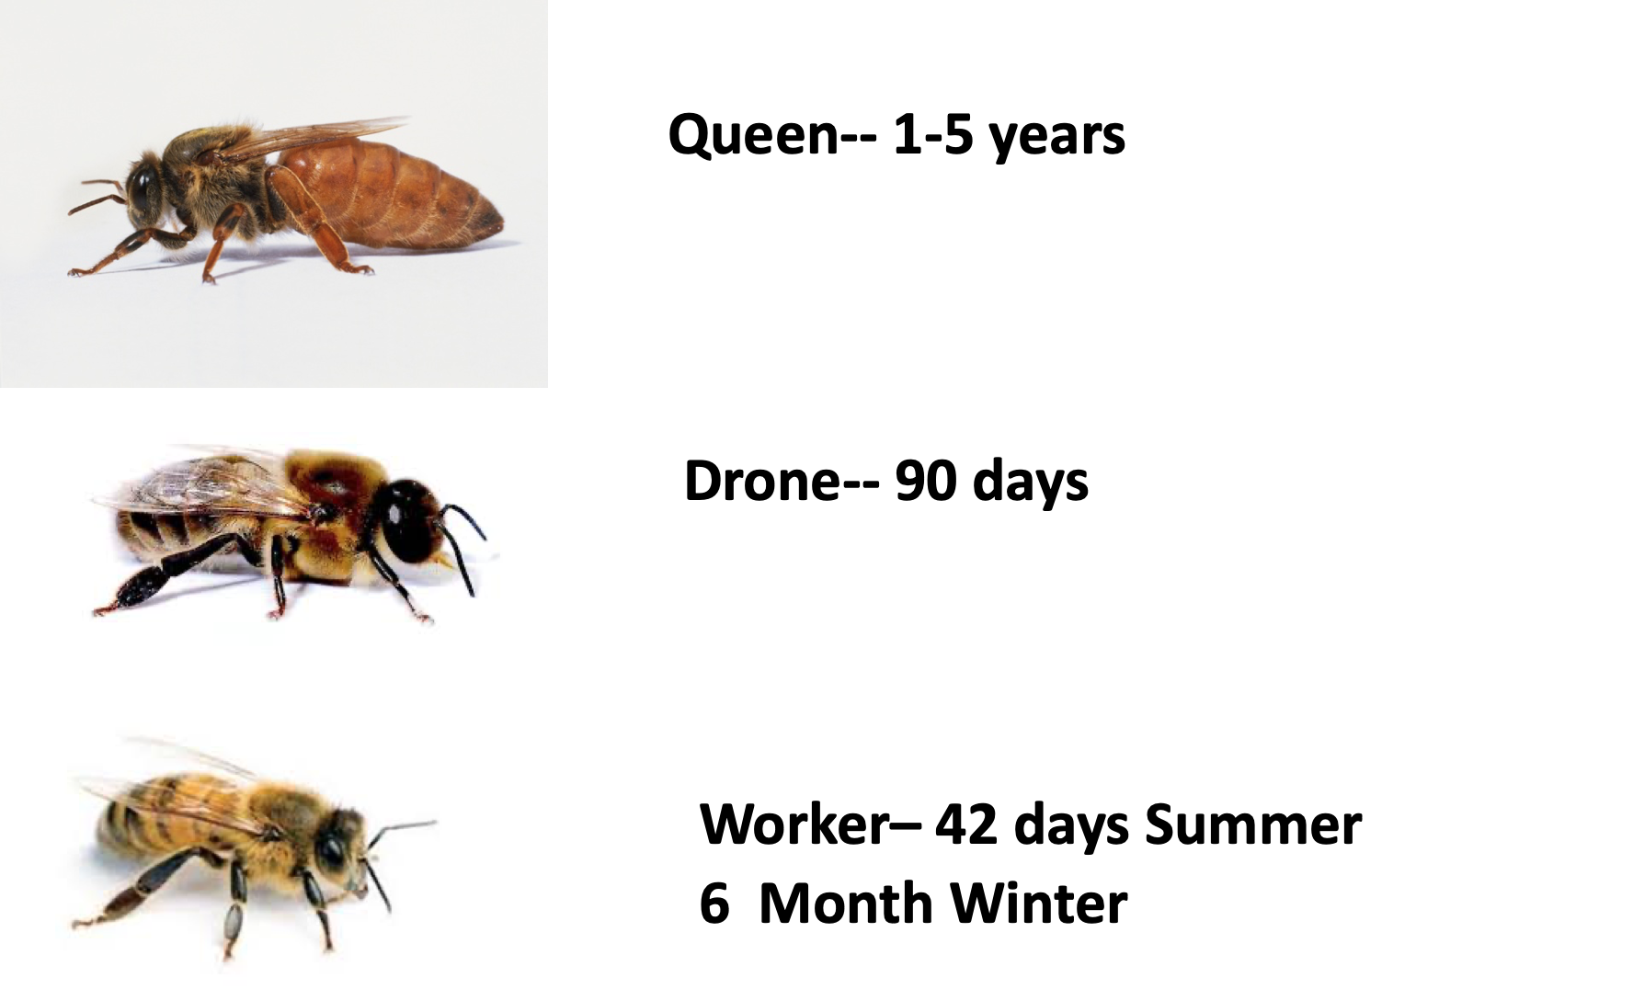
Lifespans of different types of bees

Slide 23
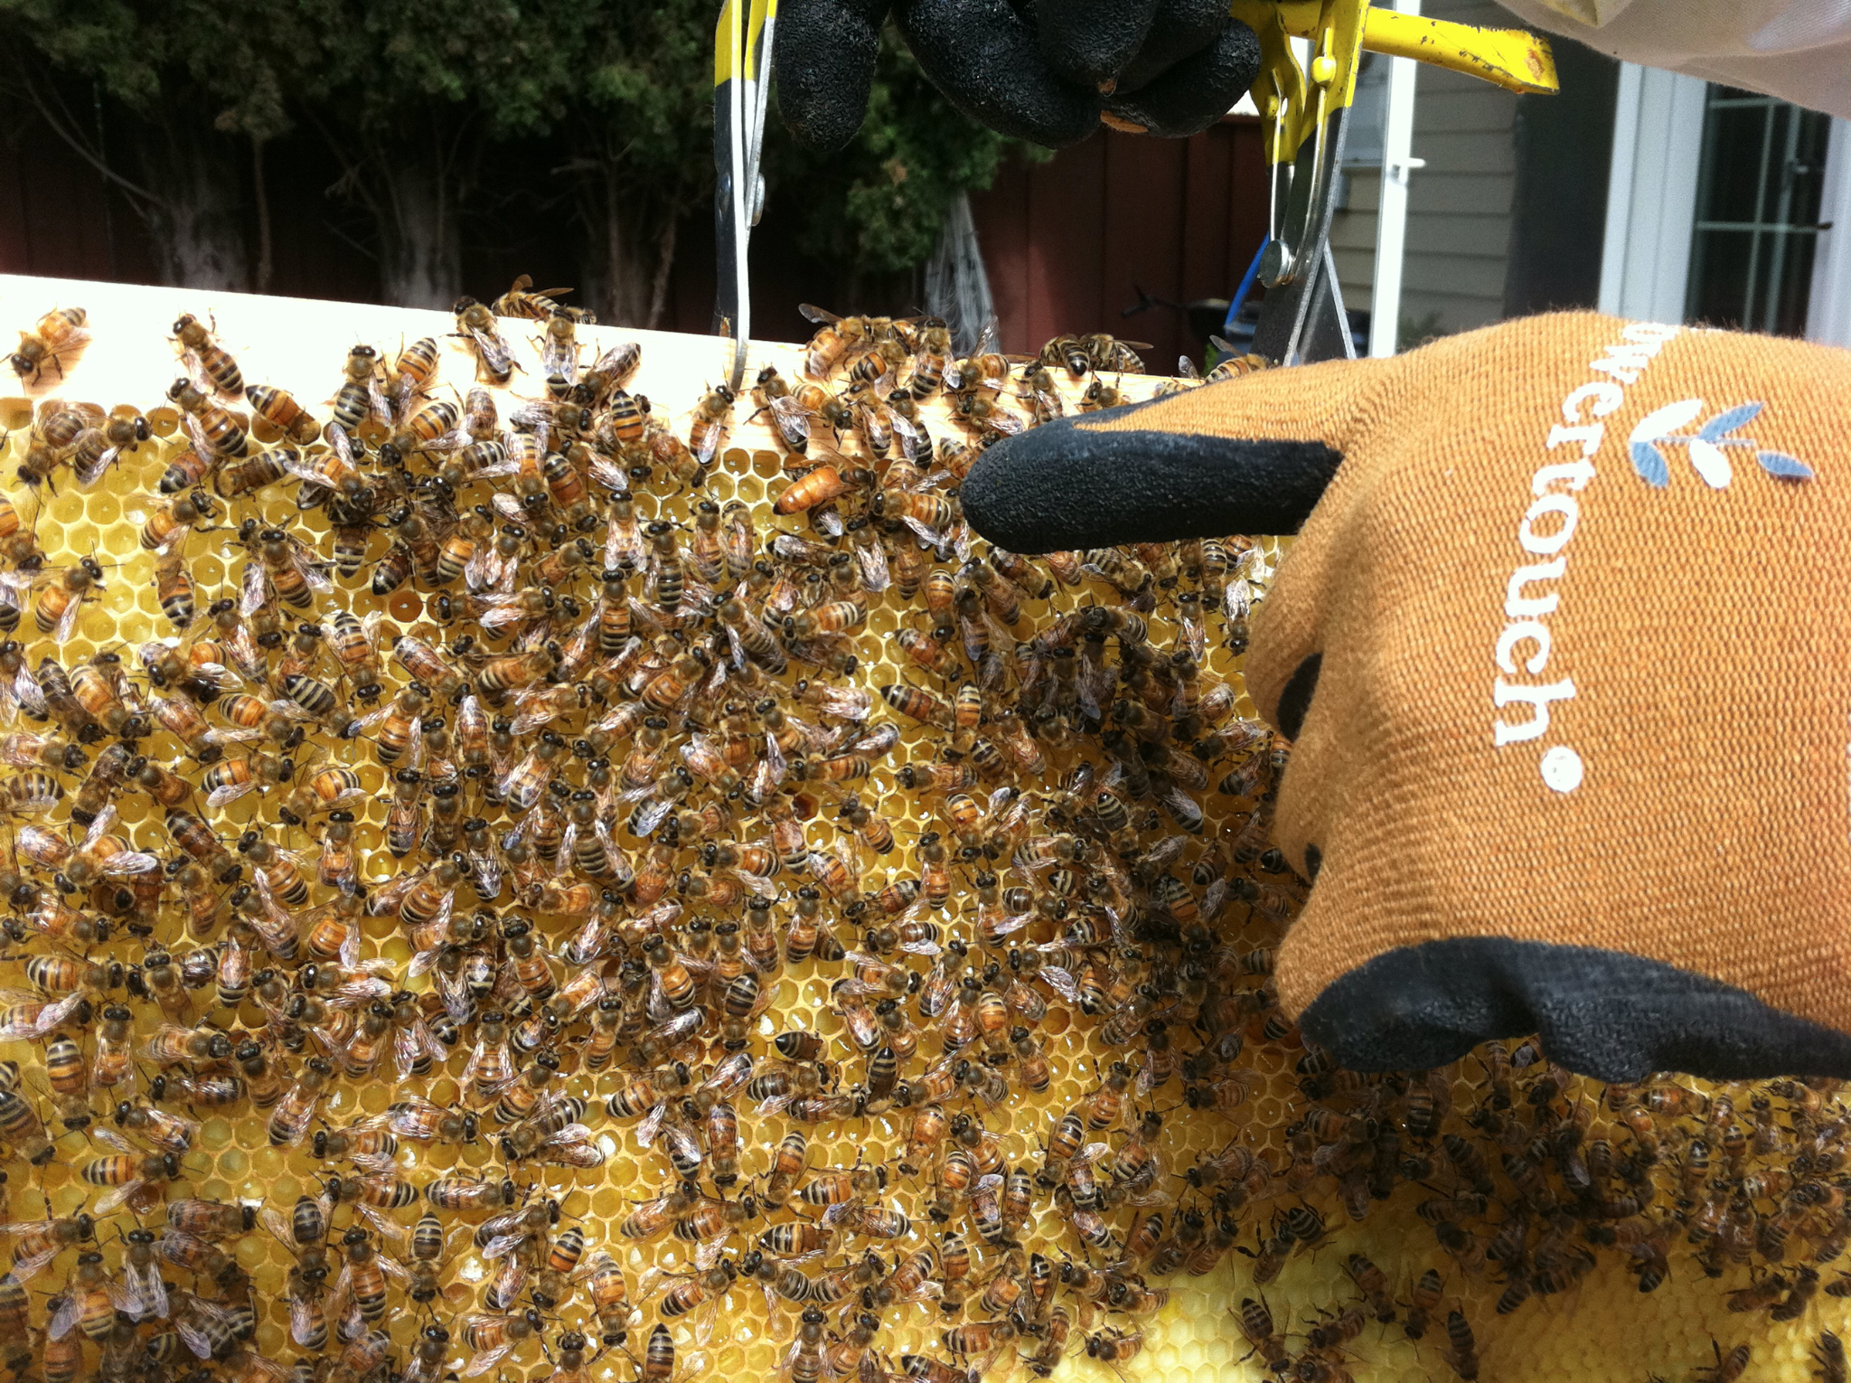

Slide 25
What do beehives look like?

Slide 26
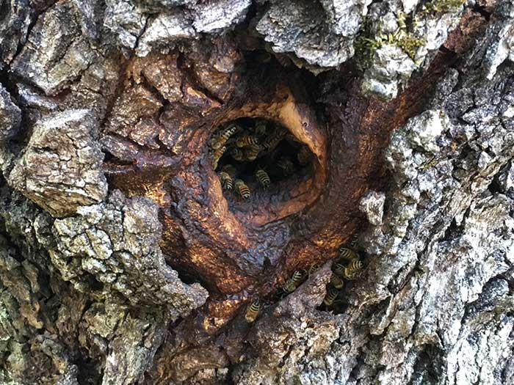

Slide 27
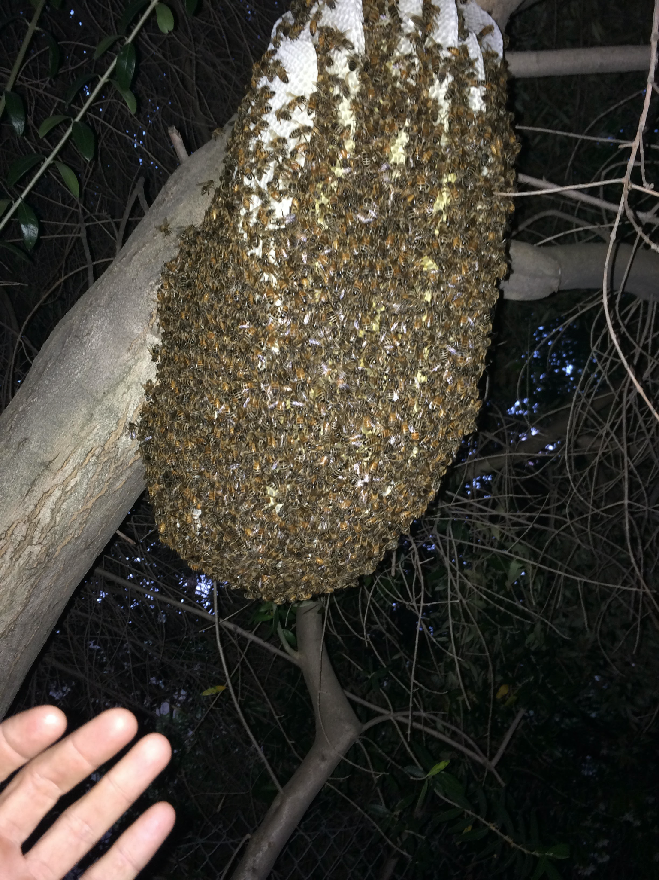

Slide 28
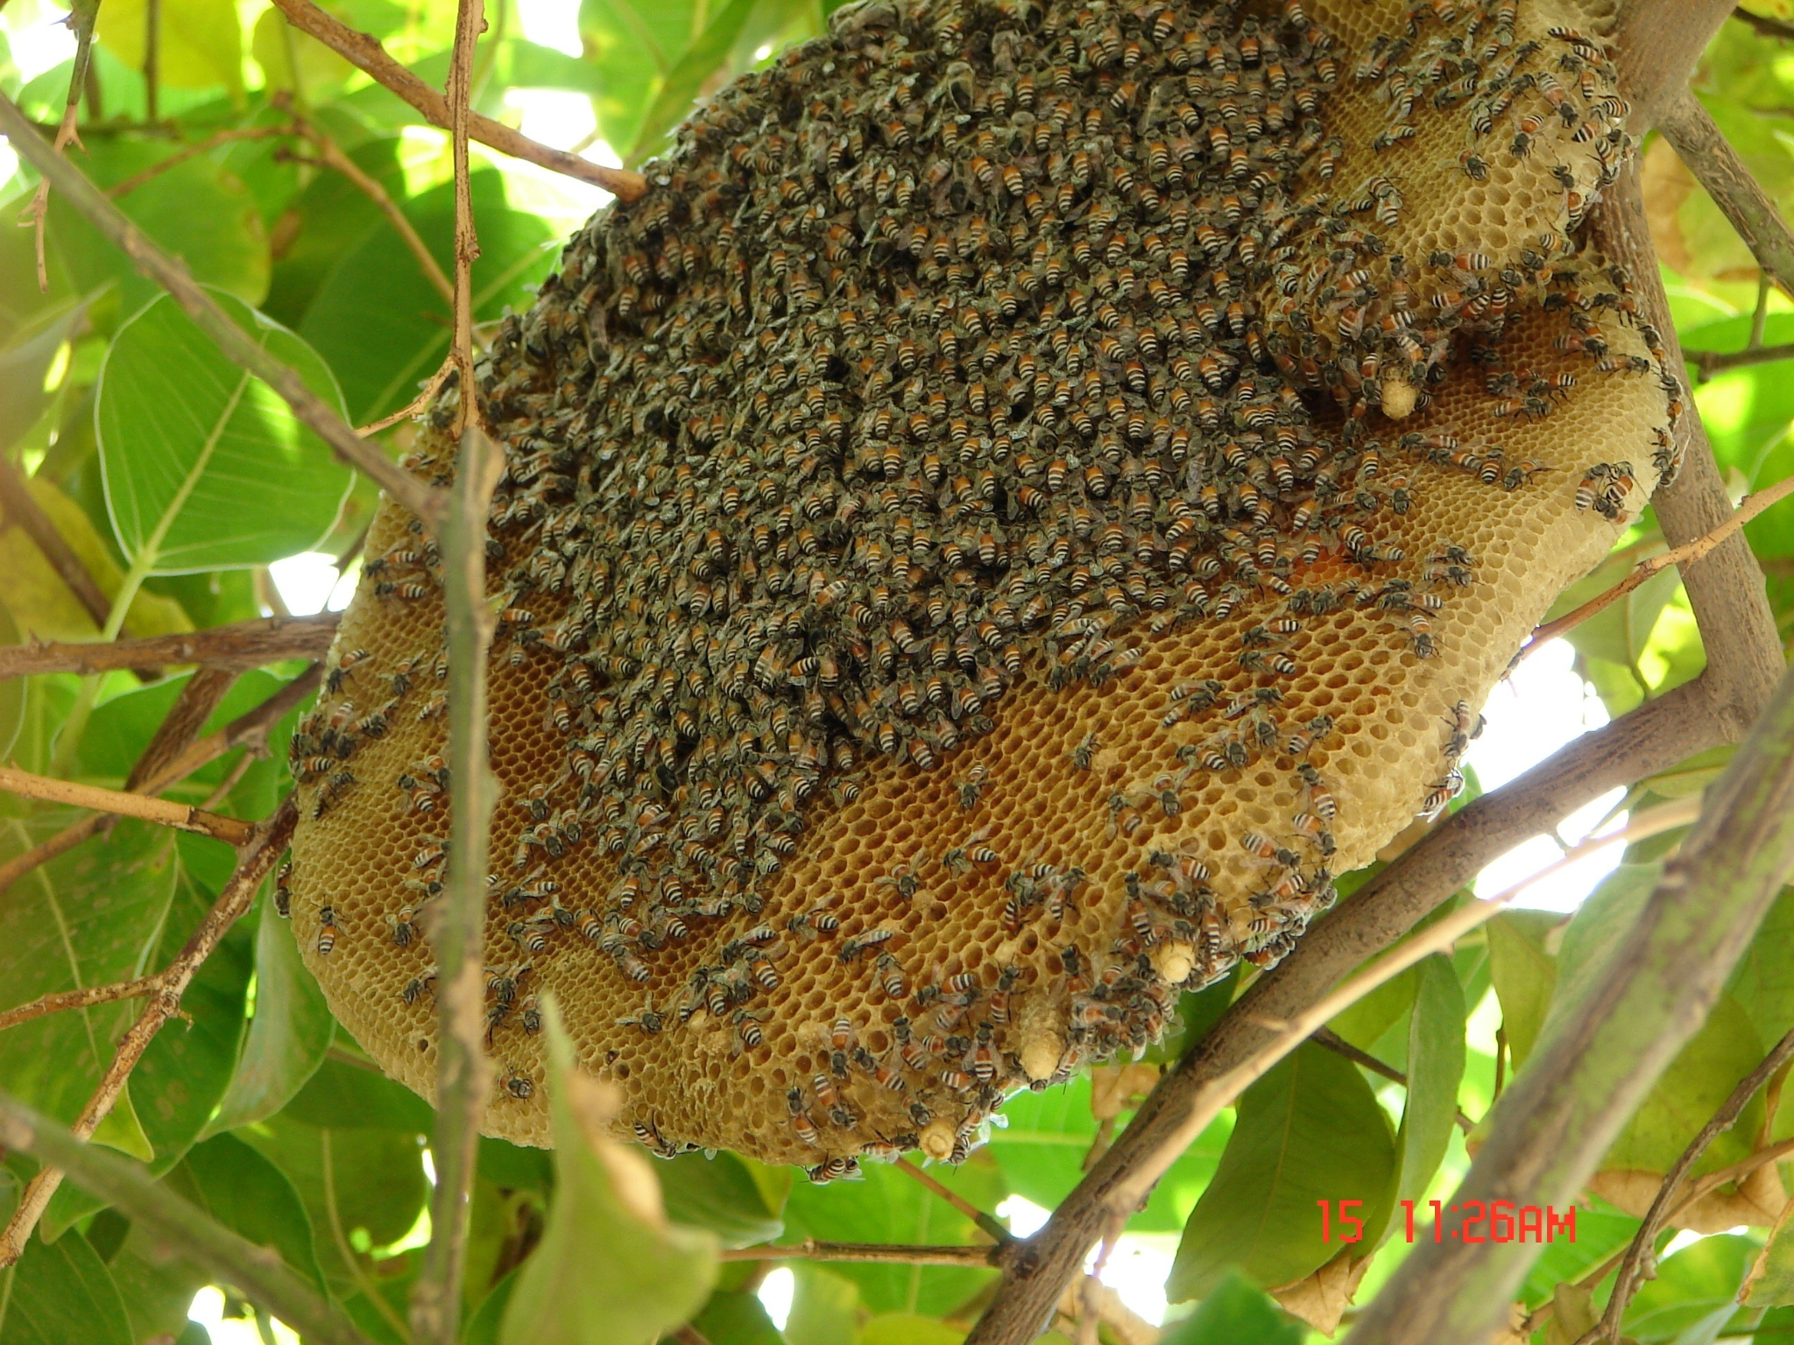

Slide 29
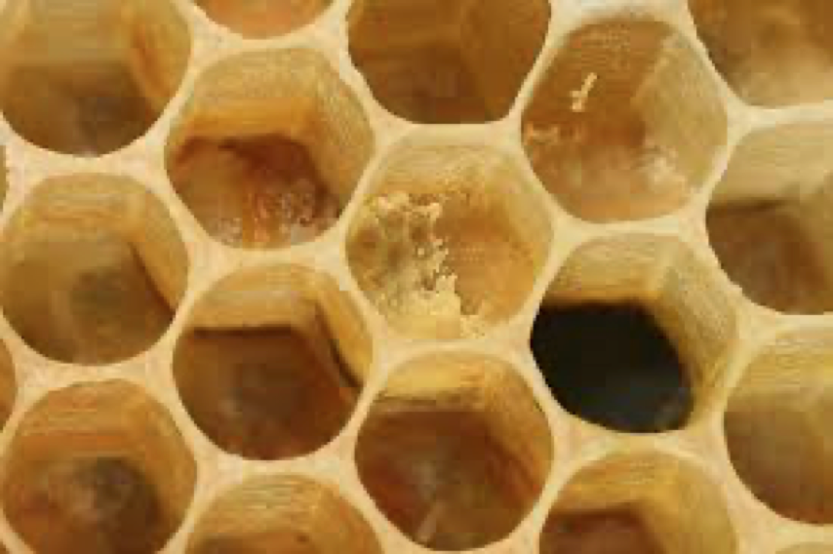
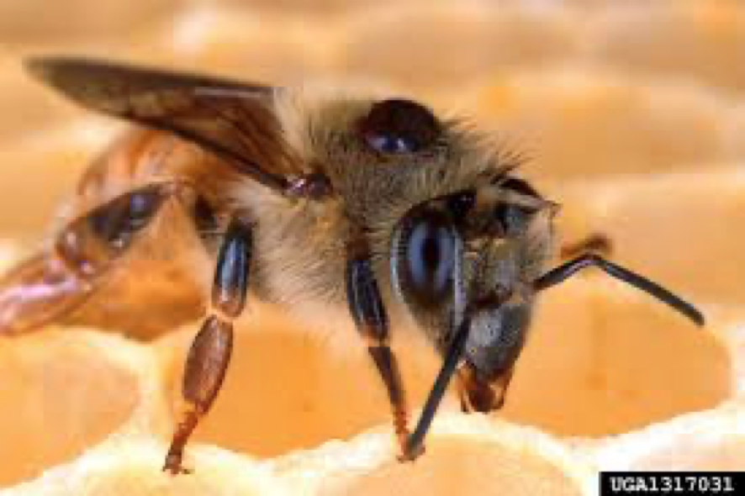
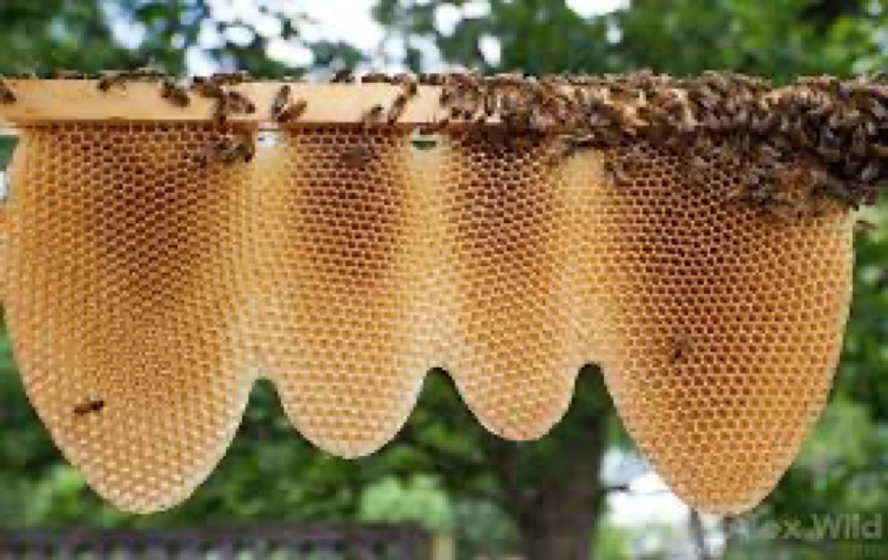
What is honeycomb?
Bees make cells to
raise bees and store
Honey. The cells are a
hexagon structure

Slide 30
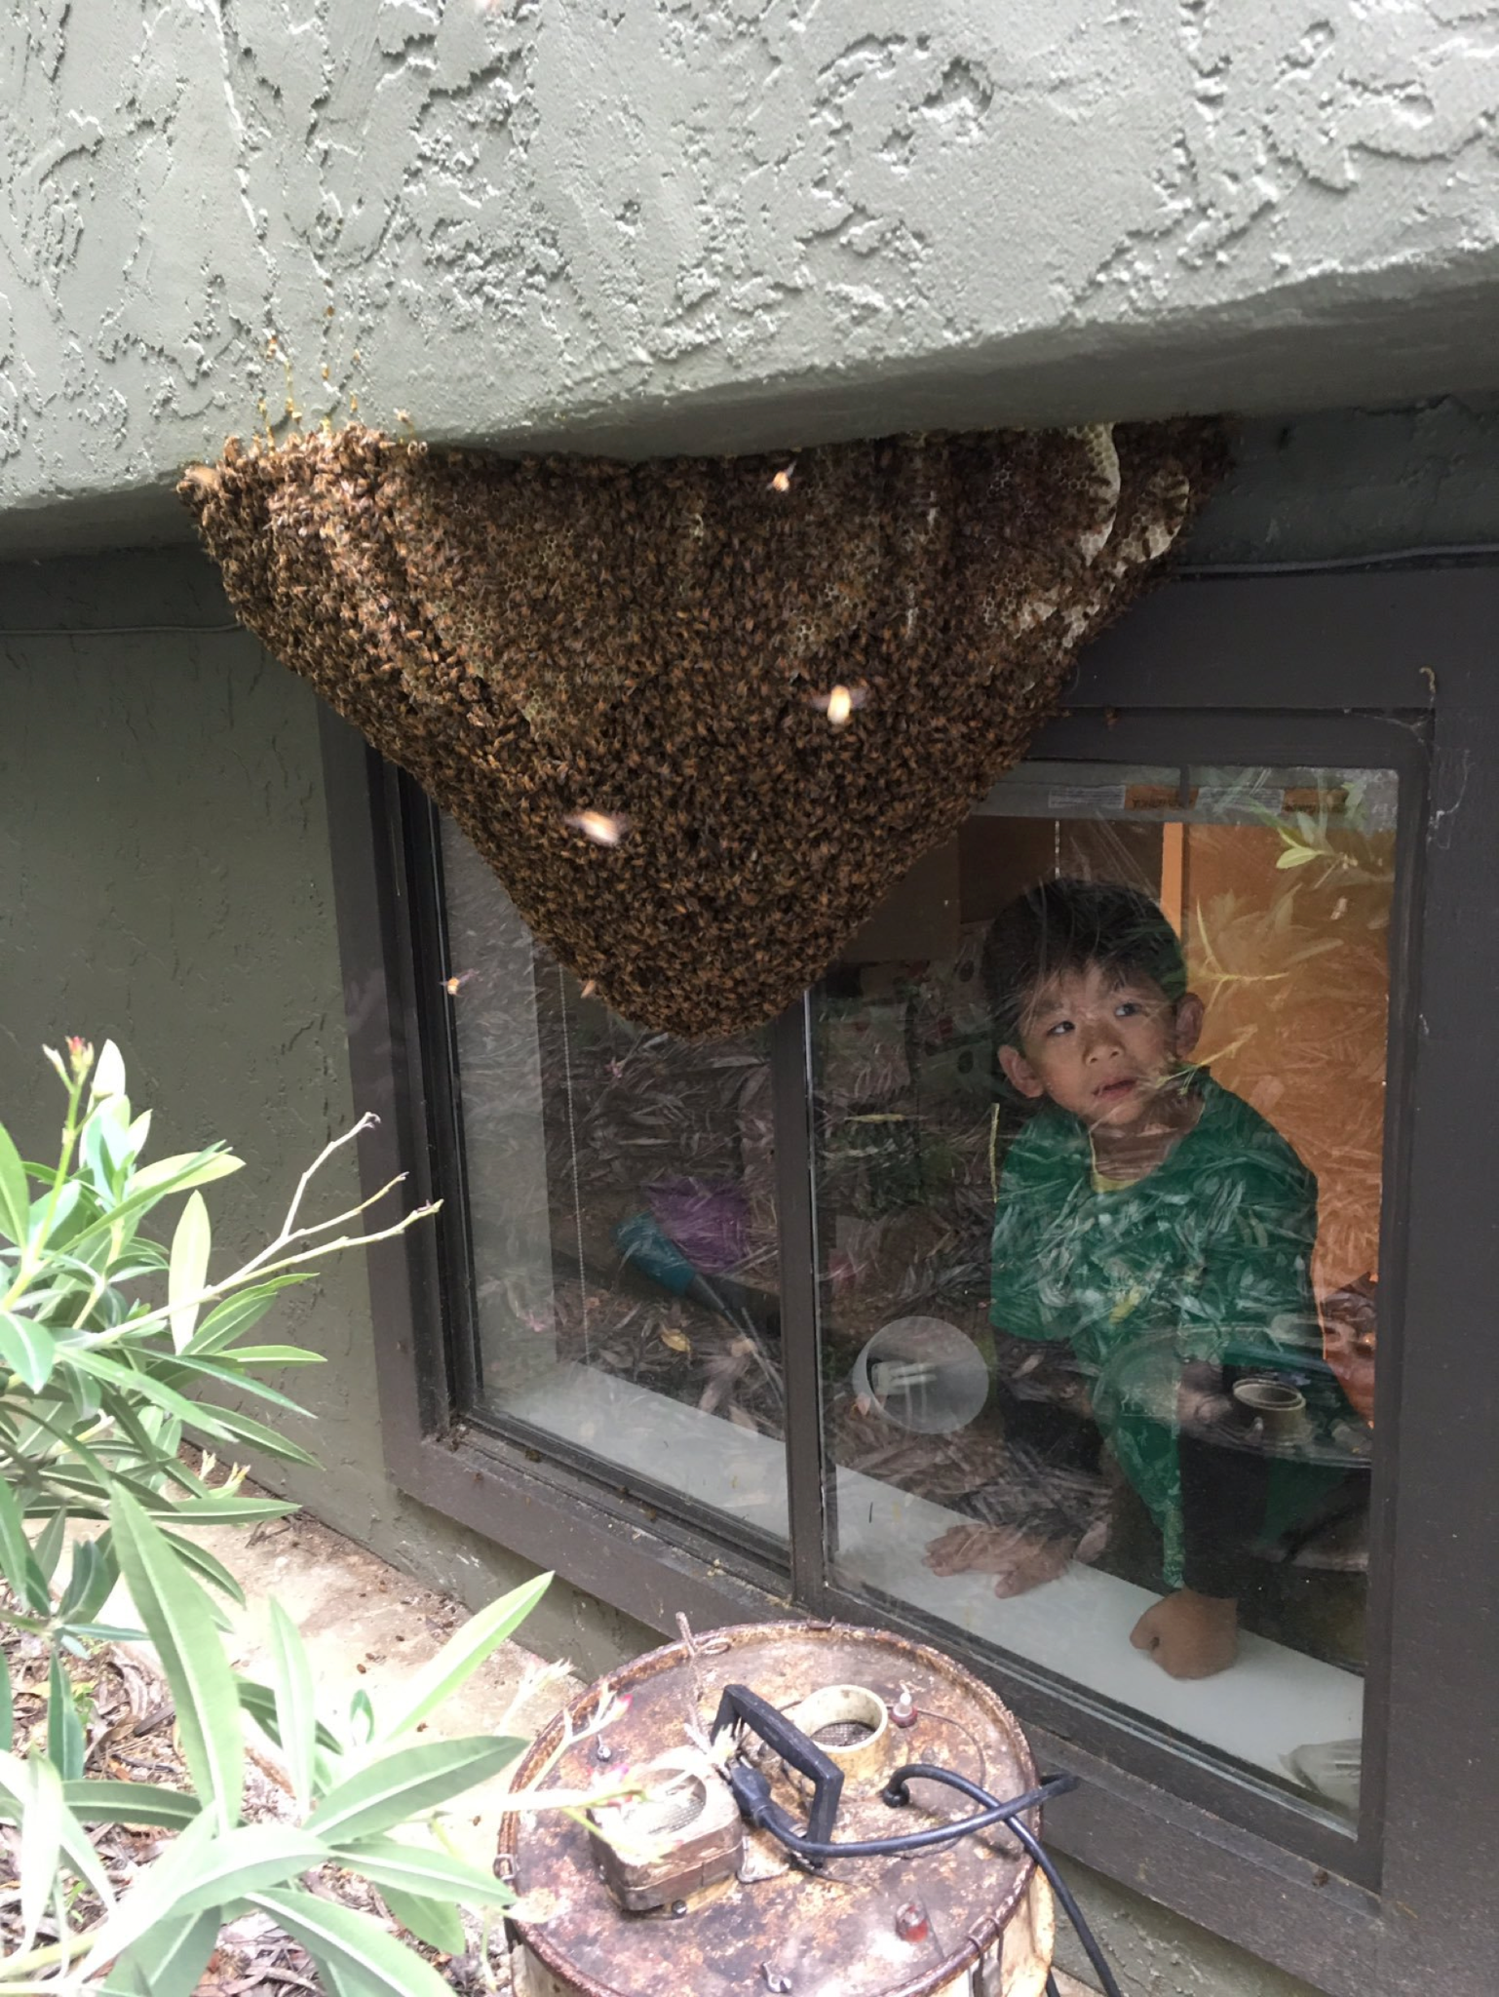
A really big hive right next to the window!

Slide 31
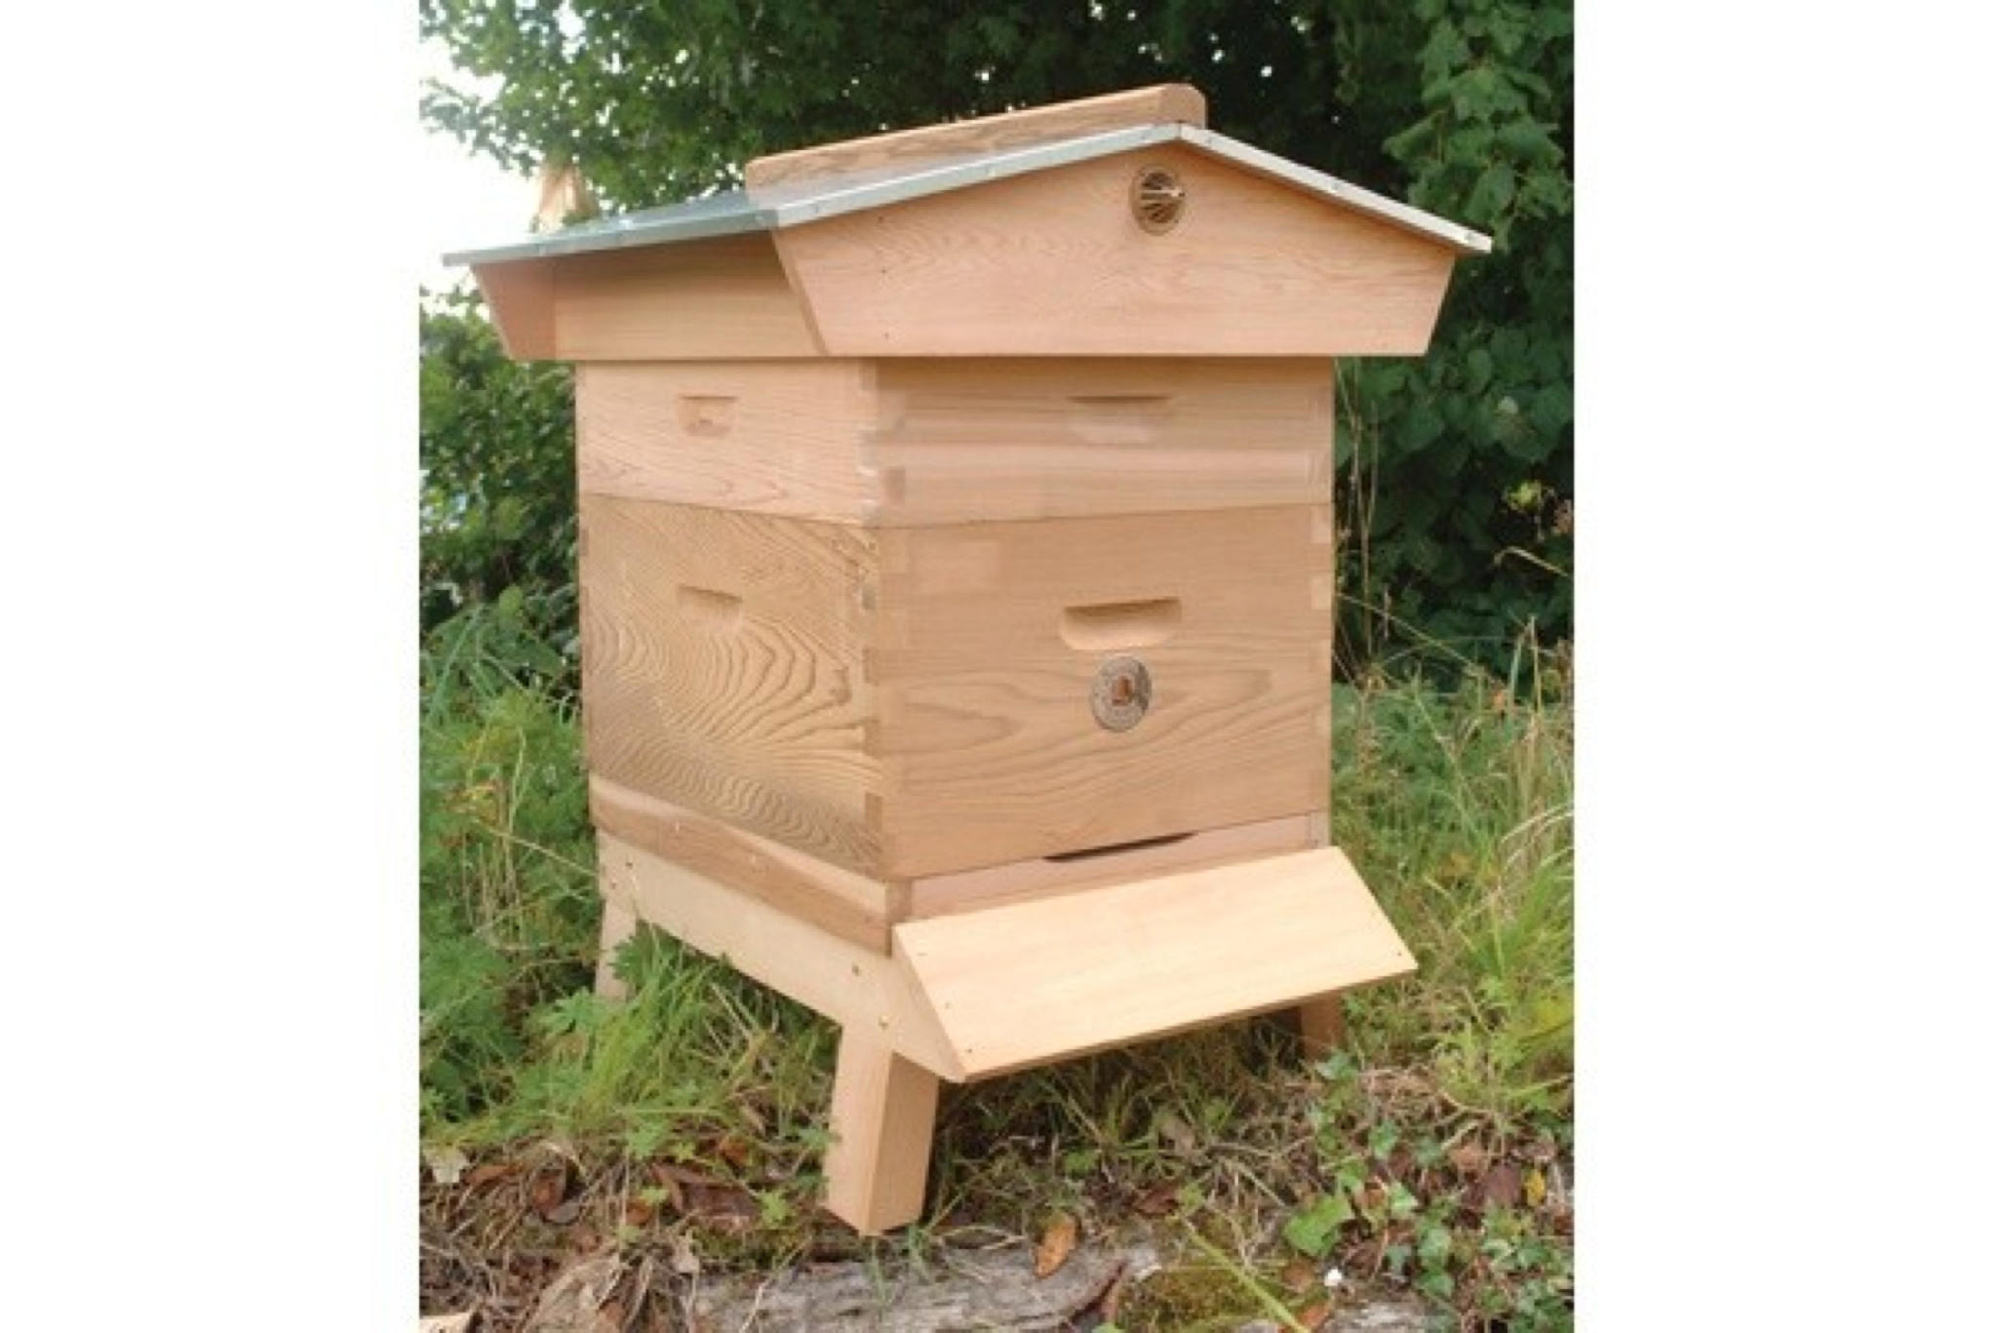

Slide 32
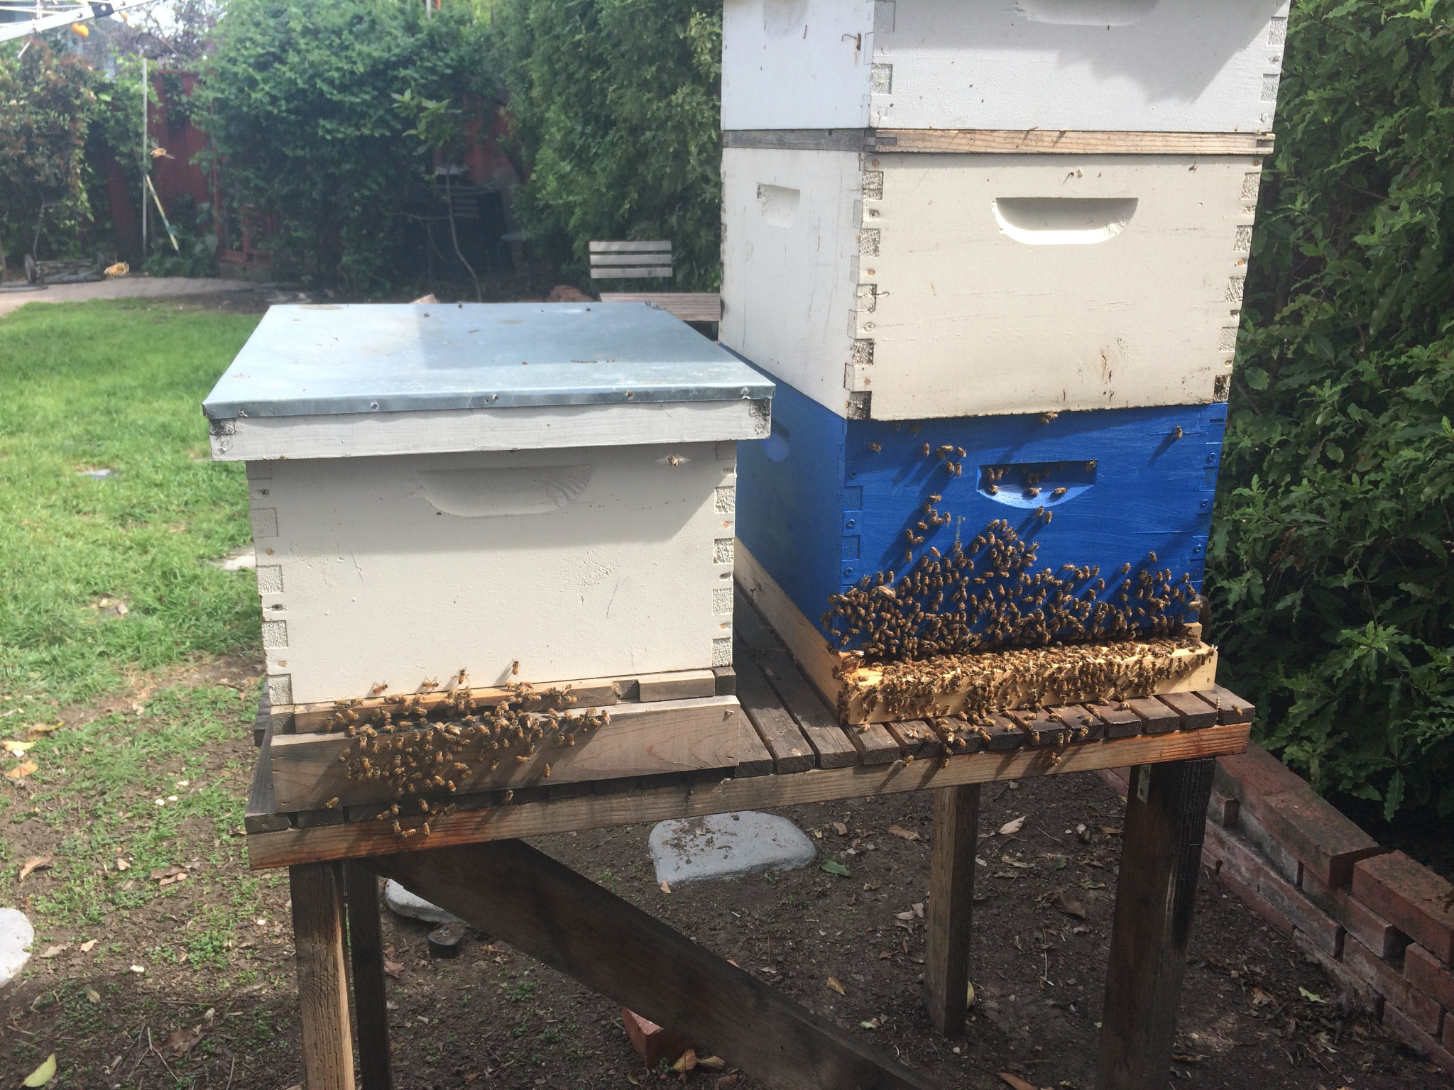

Slide 33
Let’s look at a pieces of a beehive!

Slide 34
What can we do to help pollinators?

Slide 35
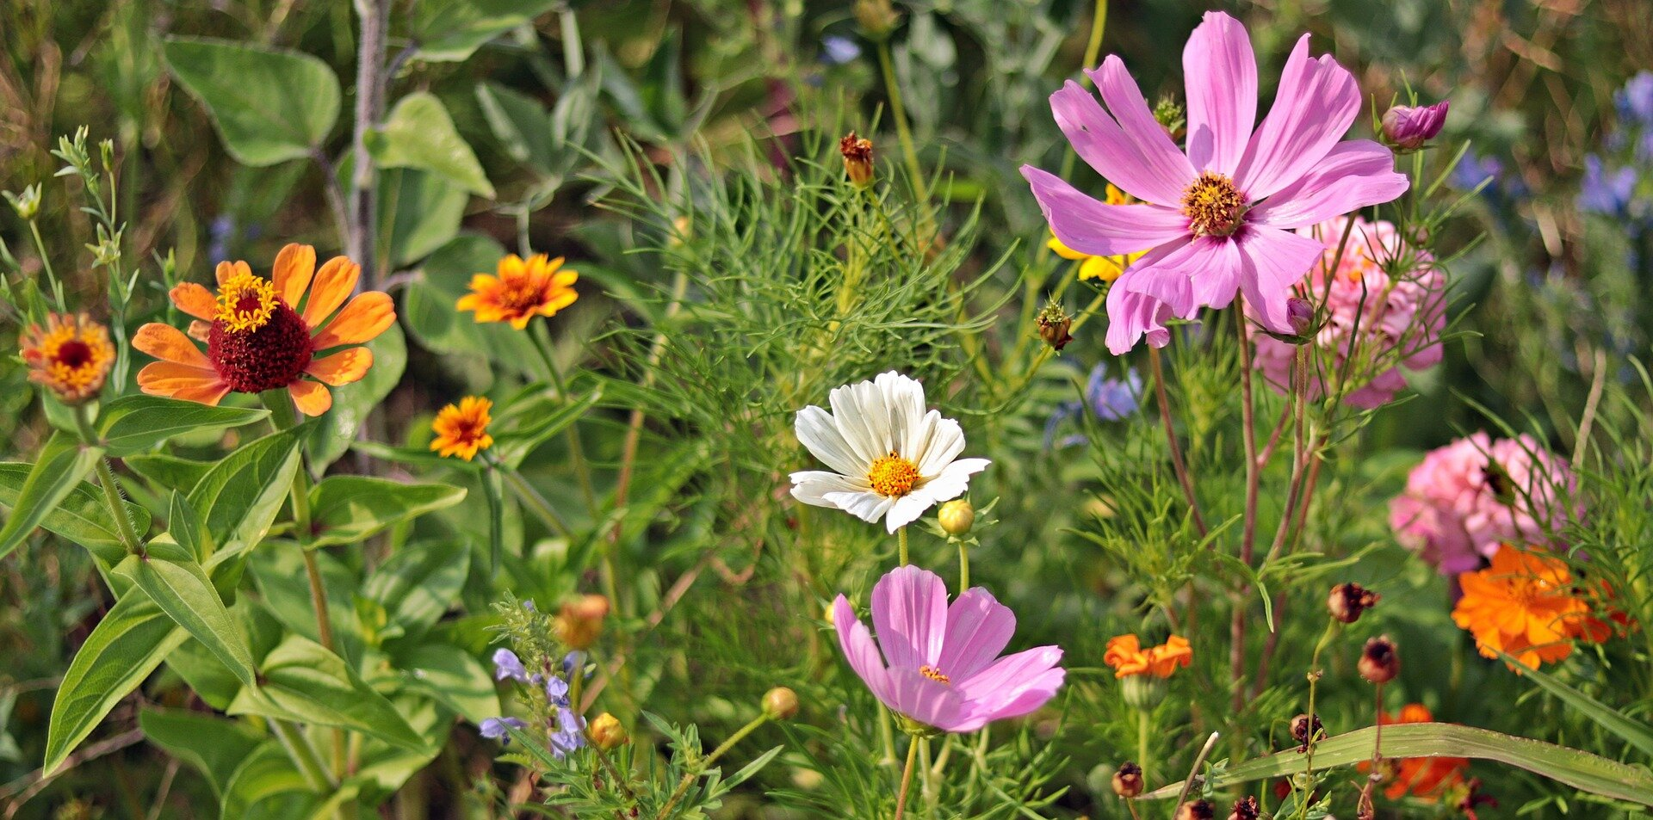
What can we do to help pollinators?
Add plants that flower at different times of the year so there is food all year round.

Slide 36
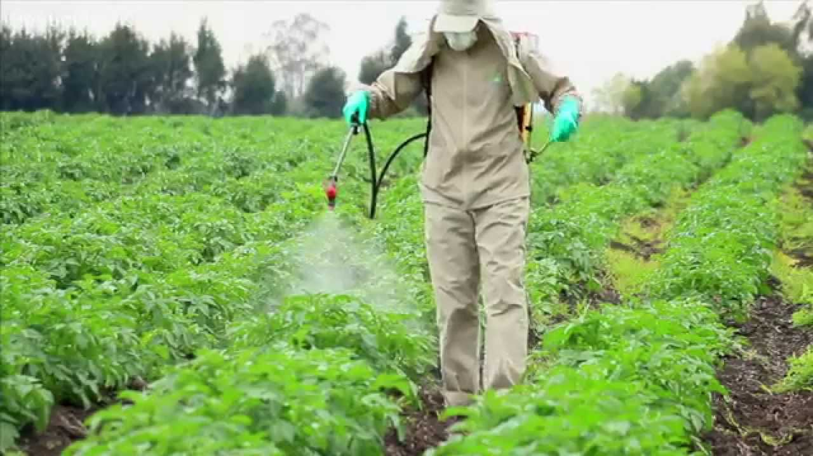
What can we do to help pollinators?
Reduce our use of pesticides and chemicals. Garden organically.

Slide 37
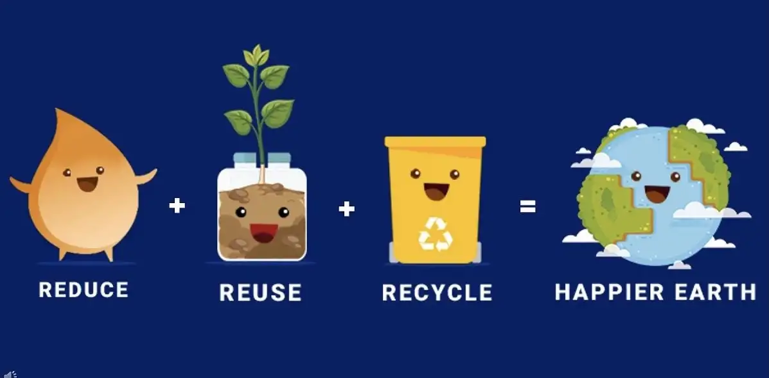
What can we do to help pollinators?
Conserve our resources. Reduce, Reuse, Recycle.

Slide 38

What can we do to help pollinators?
Share these ideas with others.

Slide 39
End

Slide 40
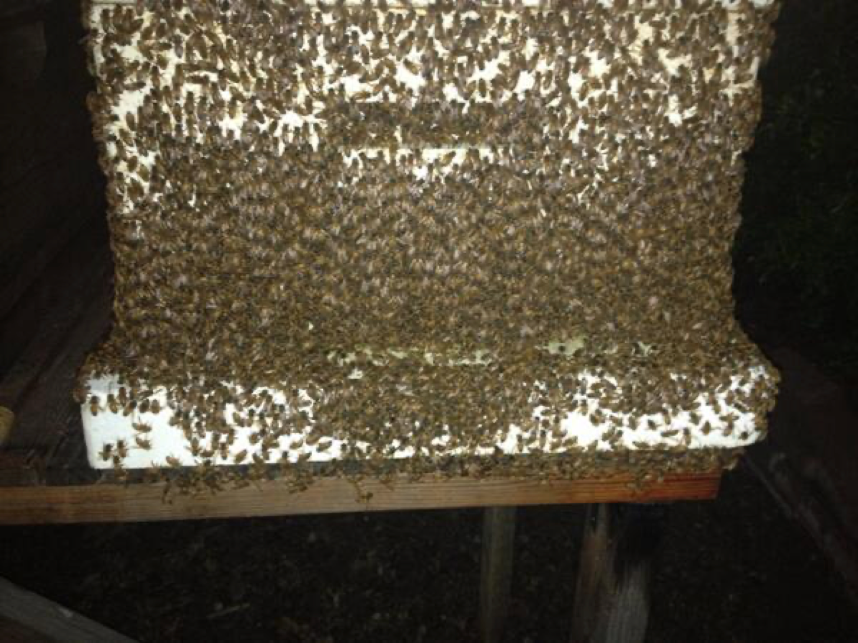
Everyone makes sure the hive stays cool on a warm evening

Slide 41
Who has ever been stung by a wasp or a bee?
What was it like for you?

Slide 42
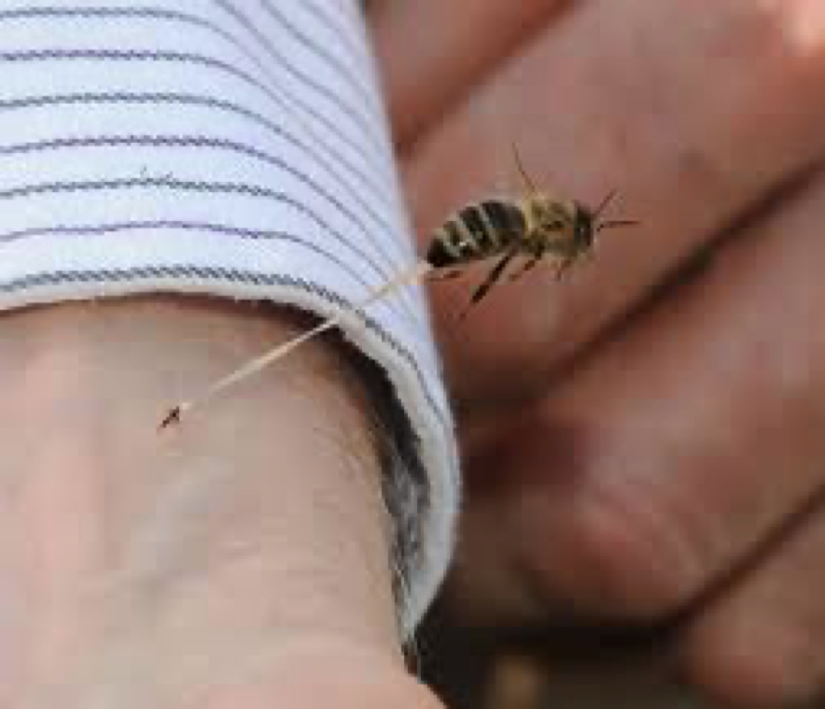
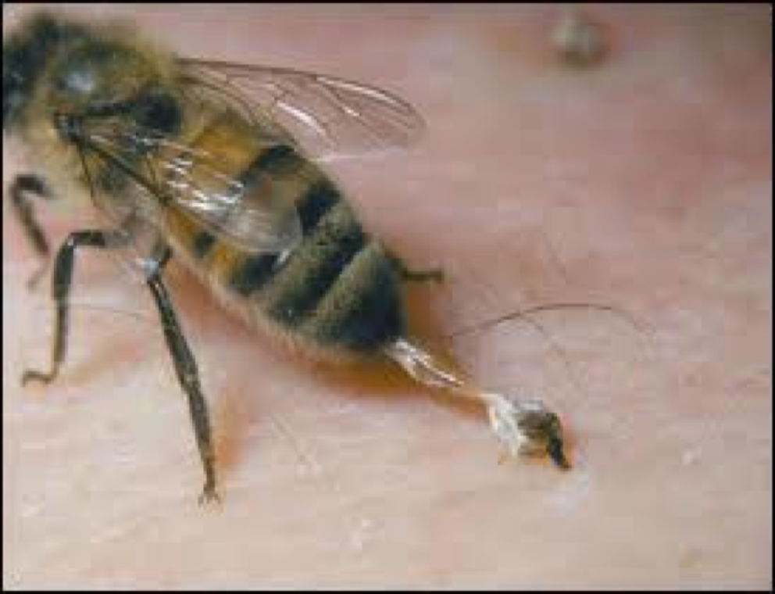
We get hurt. But the honey bee dies!

Slide 43
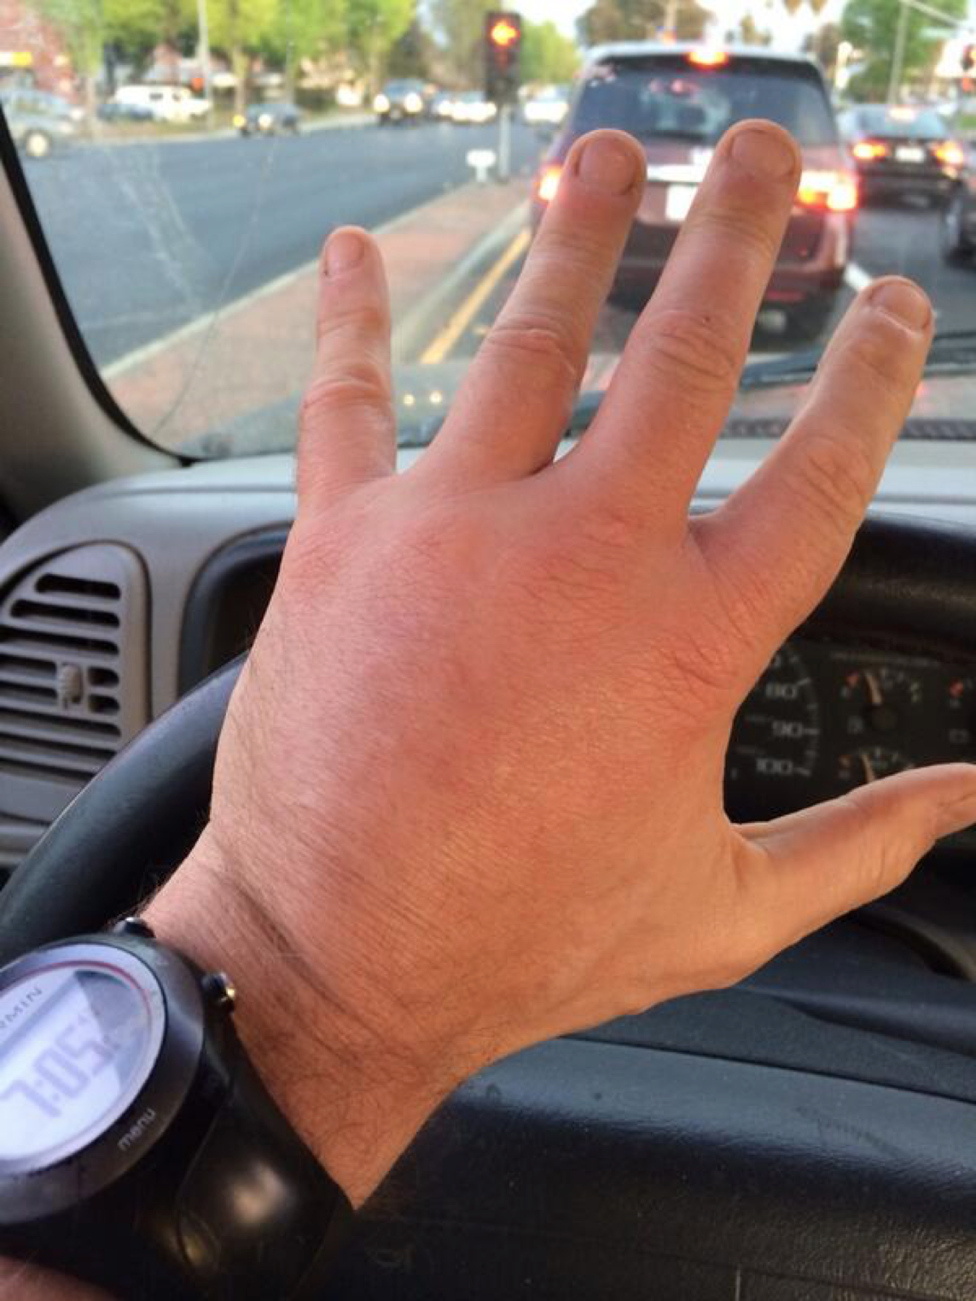

Slide 44
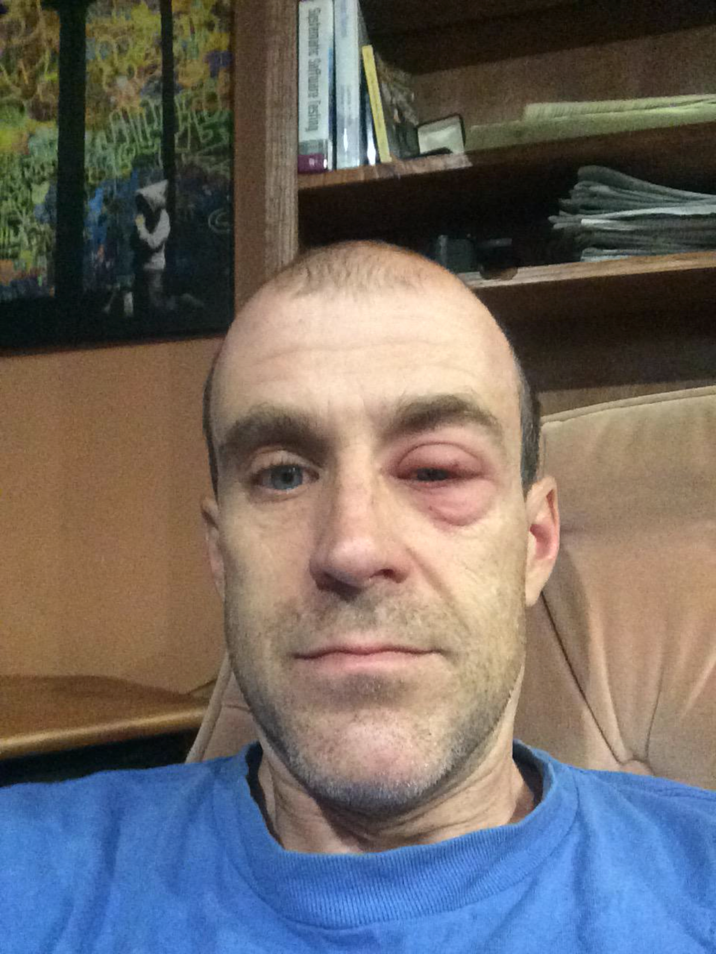
Your eyeball would be a very bad place to get stung.
Luckily, eyelids are very good at protecting eyeballs!

Slide 45
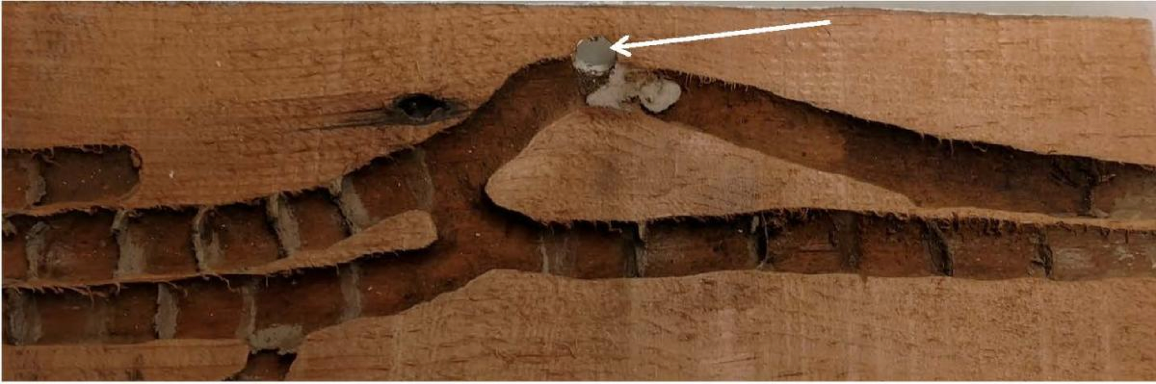
Inside a Carpenter Bee Hive

